Slide 1
Technology Outlook
Automated Driving 2024 Edition
Steering Automated Vehicles To A Better Future

Slide 2
Saudi Aramco Technology Outlook Series
Automated Driving: A Global Outlook
Acknowledgement
Authors:
Jinghui Wang, Xin He
Strategic Transport Analysis Team – Detroit
Aramco Research Center
46535 Peary Ct., Novi, MI 48377

Slide 3
Table of Content
Section i
CTO Foreword
Acknowledgements
Executive Summary
Automated Driving History
Policy and Regulations
Market assessment
Technologies
Implications on Transport Energy and Emissions
Challenges for Automated Driving Development
Section ii
Section iii
Section 1
Section 2
Section 3
Section 4
Section 5
Section 6

Slide 4
Automated Driving History
Automated vehicle (AV) technologies have been developed for several decades and achieved great advancements over the past 10 years given the breakthrough of computing, sensor, and communication technologies. AV is anticipated to tremendously improve traffic safety and mobility, yet it will also significantly impact transport energy demand and emissions.
This section will give an introduction about the history of automated vehicle covering the following areas:
Definitions and terminologies
Motivation of automated driving
Development history
Publications and patents

Slide 5
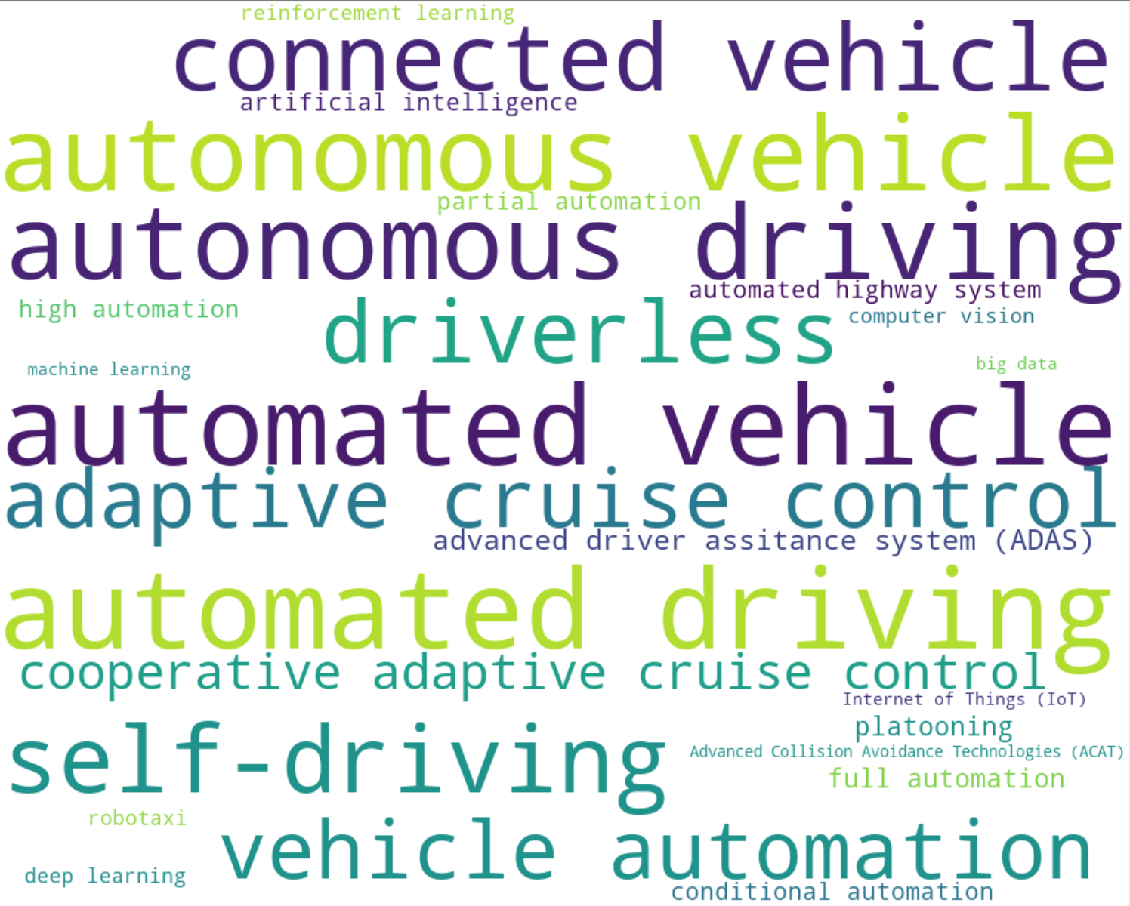
Definitions and Terminologies
There are numerous words and terminologies describing automated vehicles, as presented in the word cloud below. Some of the most commonly used words include automated vehicle, automated driving, autonomous vehicle, autonomous driving, self-driving, driverless, vehicle automation, connected vehicle, adaptive cruise control, advanced driver-assistance system (ADAS), and so forth.
In most of the state-of-the-art, automated, autonomous, self-driving, and driverless are all used to refer to automated driving, yet they differ each other. Based on the definition of U.S. Department of Transportation (DOT), their differences mainly depend on the degree of human intervention as requested. Generally, automated and self-driving require human input while autonomous and driverless can fully self-control. It is safe to conclude that the latter is the higher level of the former.
Automated vehicles are those in which at least some aspects of a safety-critical control function (e.g., steering, throttle, or braking) occurs without direct driver input. Vehicles that provide safety warnings to drivers (forward crash warning, for example) but do not perform a control function are, in this context, not considered automated, even though the technology necessary to provide that warning involves varying degrees of automation. Automated vehicles may use onboard sensors, cameras, GPS, and telecommunications to obtain information in order to make their own judgments regarding safety-critical situations and act appropriately by effectuating control at some level. A self-driving vehicle is a vehicle having ability to drive by itself using onboard sensors but requiring human back-up to intervene whenever needed. It is pretty similar to automated vehicle. Autonomous vehicles are those capable of sensing its environment and navigating using techniques like radar, LIDAR, GPS, or computer vision, without any human input. A driverless car is a robotic vehicle that is designed to travel between destinations without a human operator. To qualify as fully autonomous, a vehicle must be able to navigate without human intervention to a predetermined destination over roads that have not been adapted for its use. (source: U.S. DOT)

Slide 6
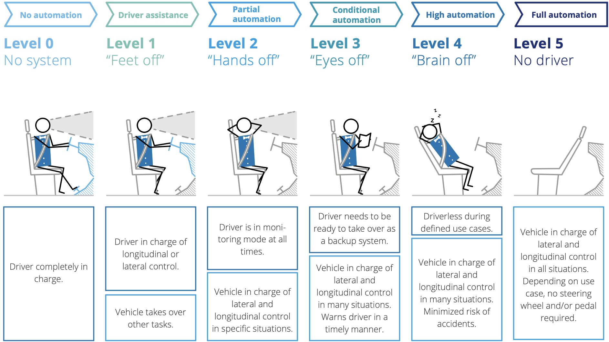
Definitions and Terminologies
SAE Levels of Automation
SAE International officially pronounced levels of vehicle automation in 2014 (revised three times after that), with a total of 6 levels being defined. Level 0 is completely human-driven at which vehicles may provide driver alerts such as collision warning but cannot perform any level of self-control. For Level 1, vehicles can perform either longitudinal or lateral control but not both. At Level 2 which also refers to partial automation, vehicles are in charge of both longitudinal and lateral control in specific situations and drivers are in monitoring mode at all times. Level 3, also referred to conditional automation, enables vehicles to perform both longitudinal and lateral control in many situations; drivers do not have to always monitor driving environment yet are required to take over at any time as needed. For Level 4 which is high automation, vehicles are able to control longitudinally and laterally as well and realize driverless in some defined use cases. Level 5, also referred to full automation, is completely driverless.
Source: Deloitte research 2018, SAE International 2014.
According to the SAE level of automation, automated or self-driving vehicle refers to any vehicle equipped with driving automation technologies (SAE Levels 1—5), while autonomous or driverless only refers to Levels 4-5. Also, U.S. DOT proposed two driving automation systems: Advanced Driver-Assistance Systems (ADAS) and Automated Driving System (ADS). ADAS is designed to help drivers with certain driving tasks (e.g., staying in the lane, parking, avoiding collisions, reducing blind spots, adaptive cruise control (ACC), platooning, etc.). With respect to automation, some of ADAS features could be considered SAE Level 1 or Level 2, but many are Level 0 and may provide alerts to the driver with little or no automation. ADS is able to perform the entire Dynamic Driving Task on a sustained basis, regardless of whether it is limited to a specific operational design domain. This term is used specifically to describe a Level 3, 4, or 5 driving automation system.

Slide 7
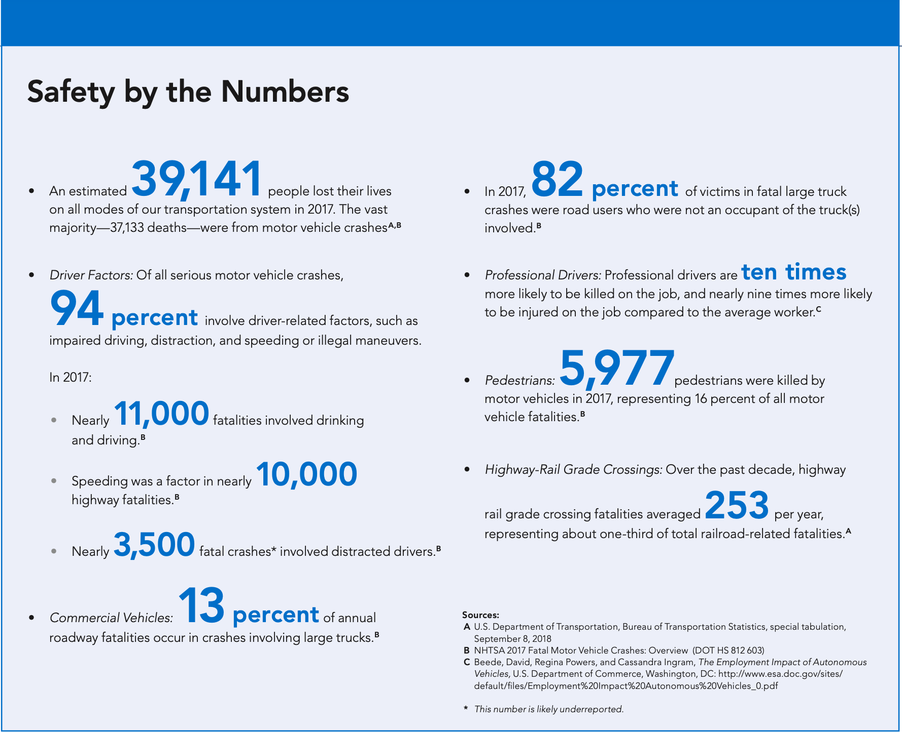
Motivation of Automated Driving
Automated vehicle technologies were originally proposed to improve mobility safety. According to the statistics of the Bureau of Transportation Statistics (BTS), 39,141 people lost their lives on all modes of transportation system in 2017 and the majority—37,133—were from vehicle crashes. 94 percent of the motor vehicle crashes were caused by driver-related factors such as impaired driving, distraction, and speeding. 13 percent of annual roadway fatalities occurred in crashes involving large trucks. 16 percent of motor vehicle fatalities had pedestrians killed.

Slide 8
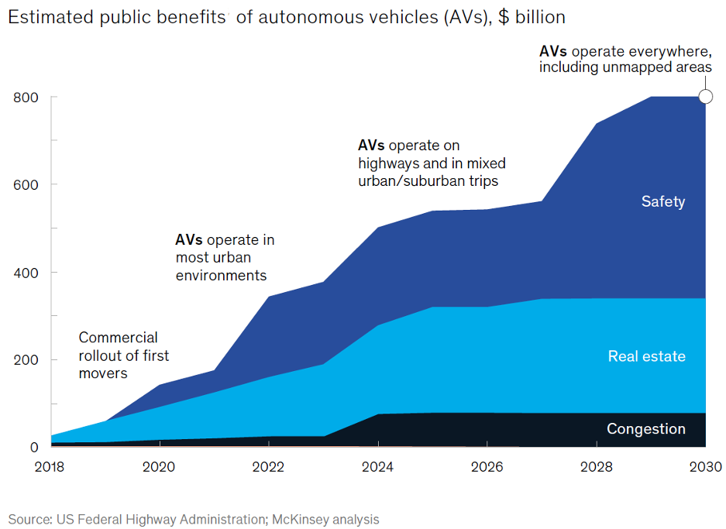
Motivation of Automated Driving
U.S. Federal Highway Administration (FHWA) and McKinsey reported that, in the United States alone, the benefit to the public would overall exceed $800 billion per year in 2030 if AVs were fully adopted. The report estimated the magnitude of the benefit under different AV deployment strategies for the years 2018-2030. More than half of the benefits would stem from safer roadways and the avoidance of millions of fatal and nonfatal accidents caused each year by human error. Nearly one-third of the benefits would arise from the public sector’s development of unnecessary parking spaces into more productive commercial or residential property. About 15% of the benefits would come from the mitigation of traffic congestion which reduce travel time and energy consumption. Other than that, higher driving efficiency of automated vehicles will also improve fuel economy and reduce emissions. However, the total energy and environmental benefits are not indicated in the report.

Slide 9
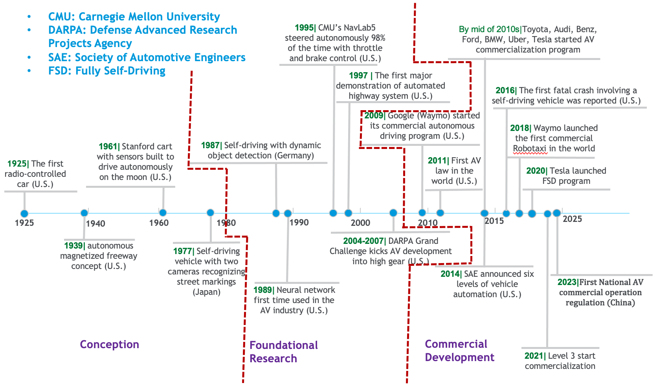
History of AV Development
The history of the automated driving could trace back to 1920s when the United States demonstrated the first version of AV named “American wonder” which was a radio controlled Sedan. However, the real progress was not made until 1980s when the breakthrough was achieved in computing, sensing, and communication technologies. AV development has been through three major phases over the past 100 years including conception, foundational research, grand challenges, and commercial development. At the stage of conception (1920s-1980), many concept cars were developed. The typical models include the vehicle propelled via magnetized system embedded in freeway (1939), the Stanford cart built to drive autonomously on the moon (1961), and the model with two cameras that was able to recognize street markings (Japan, 1977). From approximately 1980 to 2007, university research centers, transportation agencies, and automotive companies, undertook basic studies of autonomous transportation, including object detection (1987), neural network applications (1989), AV with steering autonomous control (1995), and automated highway system (1997). In particular, the DARPA launched 3 grand challenges from 2004-2007 to advance AV sensors, computing, and capability of navigation, rule obey, and detection/reaction of other vehicles’ behavior. This markedly accelerated advancements in AV technology, ignite the public’s imagination and innovation, and paved the way to commercialization. From 2007 onwards, AV development entered the stage of commercialization. Technology companies, automotive manufacturers, and transportation network companies (TNC) competitively and collaboratively worked on commercial research, AV testing, and specific program deployment (e.g. Robotaxis and autonomous shuttles). Most of the deployed programs as of 2020 offer Level 2 or below features. From 2020s, Level 3 is actively tested and will first be deployed to luxury models.

Slide 10
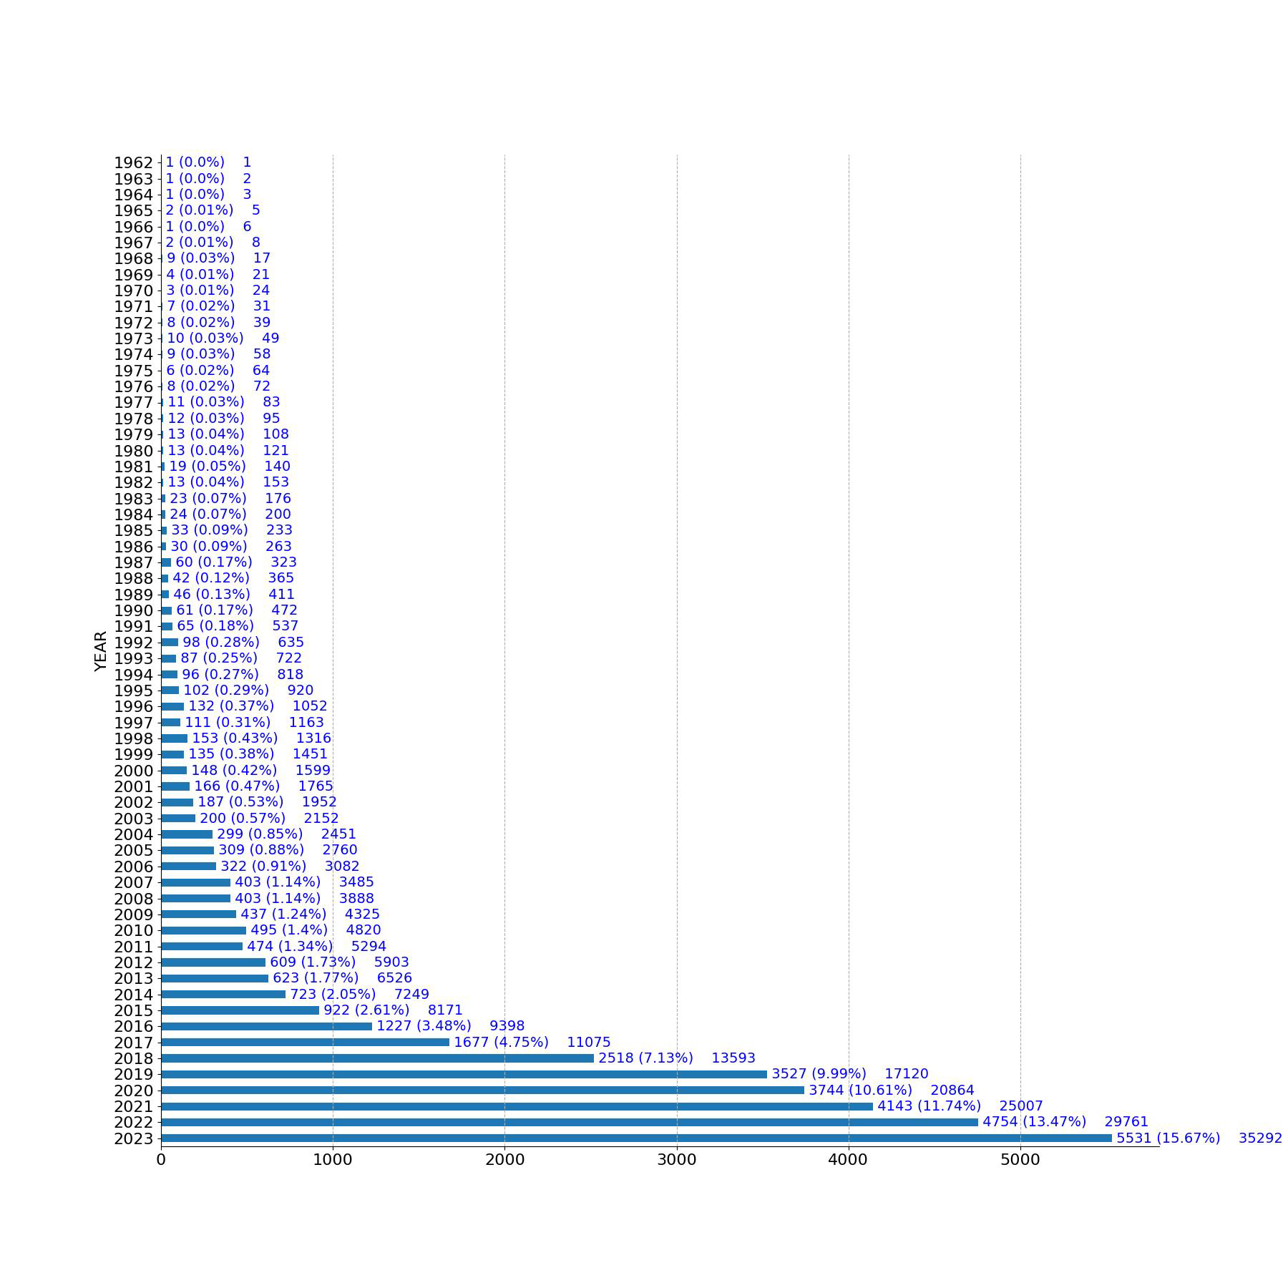
Research Publications
According to the statistics of Scopus, there are a total of 35,292 publications relative to automated vehicles (AVs) research from 1962 to 2023. Over the past 60 years, the number of documents keep increasing, especially after 2015.
Six decades of automated vehicle research (Scopus data). APO: Annual Publication Output; CG: Cumulative Growth.
APO
CG

Slide 11
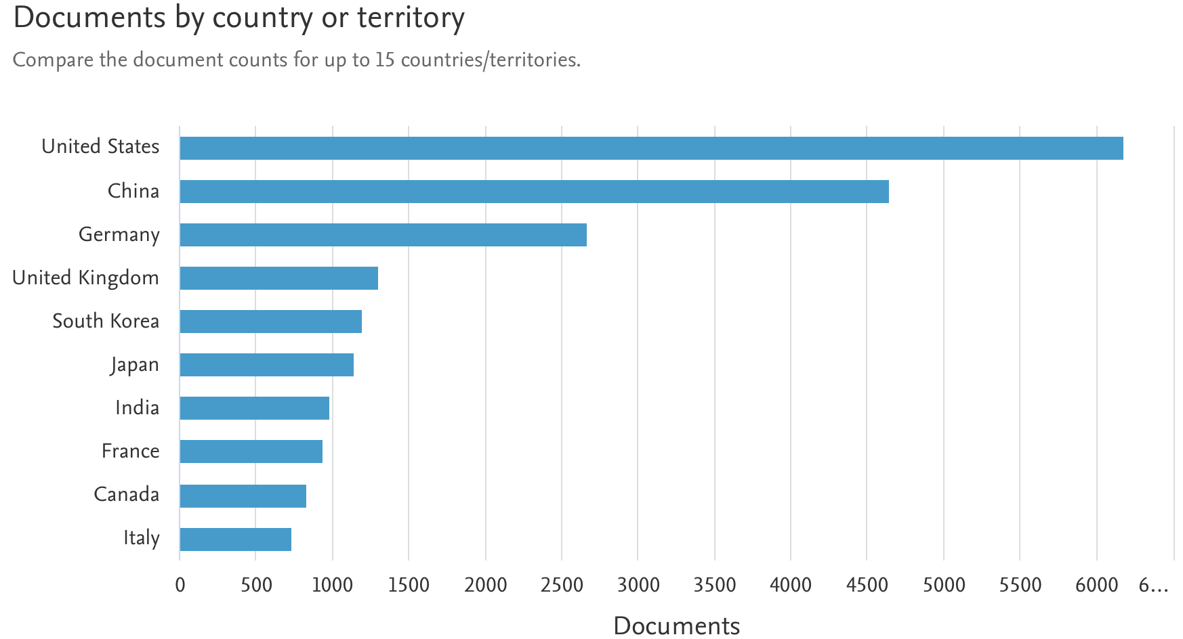
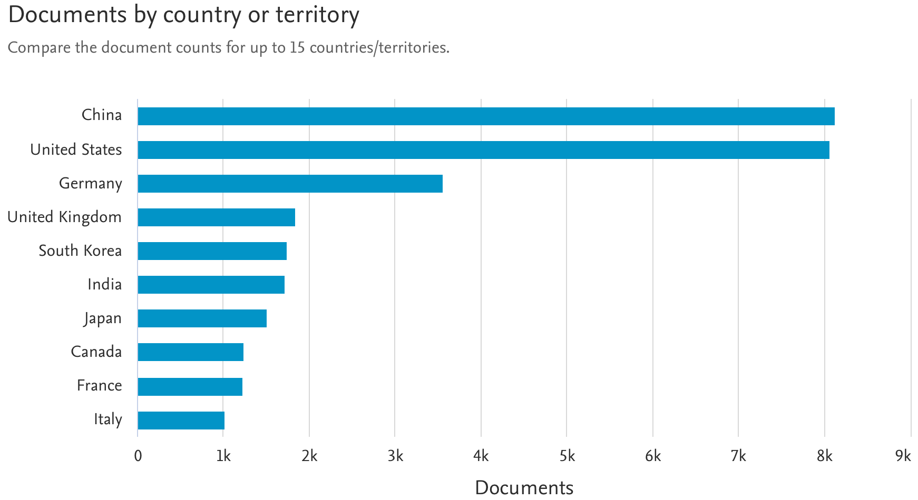
Research Publications
Scopus compares the publication counts for the top 10 countries. As of the end of 2021, the United States leads the automated vehicle research in terms of the number of publications, followed by China and Germany. However, in the end of 2023, China has surpassed the U.S.
As of 2021
As of 2023
Source: Scopus

Slide 12
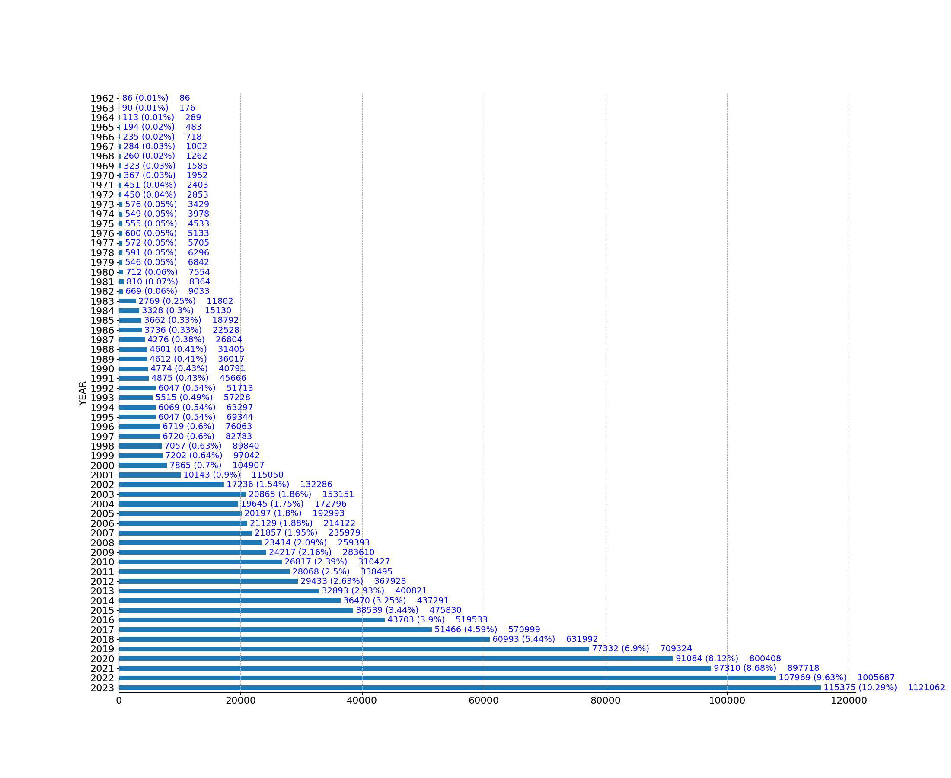
Number of Patents
Scopus reports that a total of 112,1062 patents tied to automated driving technologies from 1962 to 2023. Over the past 60 years, the number of patents in general keep increasing especially after 2017.
Six decades of automated vehicle patents (Scopus data). APO: Annual Publication Output; CG: Cumulative Growth.
APO
CG

Slide 13
Patent Owners
The data from LexisNexis PatentSight demonstrate that, from 2013 to 2022, Toyota is always the top 1 autonomous driving patent owners. Other large patent owners include Baidu, Ford, Honda, General Motors (GM), Hyundai, VW, LG, Bosch, and Kia. Noticeably, seven out of the ten owners are automotive manufacturers.
Largest patent owners in autonomous driving worldwide from 2013 to 2022 by the number of active patent families
According to McKinsey analysis based on the data from 1,183 companies, since 2010, the technology of sensors and advanced driver assistance system (ADAS) components is the cluster which holds the largest number of patents, followed by telematics and intelligent traffic, semiconductor, software and mapping, connectivity and information, human-computer interface (HMI) and voice recognition, and back-end/cybersecurity.

Slide 14
Policies and Regulations
Automated vehicle (AV) technologies have been developed for several decades and achieved great advancements over the past 10 years given the breakthrough of computing, sensor, and communication technologies. AV is anticipated to tremendously improve traffic safety and mobility, yet it will also significantly impact transport energy demand and emissions.
This section will give an introduction about AV development policies and regulations worldwide, including:
United States
China
Europe
Japan
Others

Slide 15
United States—Federal Policies
Year | Document | Key Takeaways | Department
2016 | AV 1.0: Federal Automated Vehicles Policy | The first federal policy for AV development in the U.S.; Adopt the SAE six level AV classification; Provide 15-point “Safety Assessment” for AV pre-deployment design, development and testing; Outlines Federal and State roles in regulating AVs; propose State legislation requirements and procedure; discuss current and potential new tools for AV regulation | USDOT (NHTSA)
2017 | AV 2.0: Automated Driving Systems-–A Vision for Safety 2.0 | Update AV 1.0 by prioritizing 12 vehicle safety design elements and delineating Federal and State roles in the regulation of automated driving system (ADS) with a primary focus on Level 3+ | USDOT (NHTSA)
 | American Vision for Safer Transportation through Advancement of Revolutionary technologies (AV START Act) | Establish a framework for a federal role to ensure the safety of highly automated vehicles (HAVs) | Congress
2018 | AV 3.0: Preparing for the Future of Transportation | Outlines multimodal safety guidance that indicates how automation will be safely integrated across commercial vehicles, on-road transit, passenger vehicles, and roadways; clarifies policies and roles proposed in previous versions; identifies opportunities for partnership and collaboration among stakeholders | USDOT (NHTSA)
2020 | AV 4.0: Ensuring American Leadership in Automated Vehicle Technologies | Establish U.S. government principles in AV development that consist of three core interests including protecting users and communities, promoting efficient market, facilitating coordinated efforts; for the first time propose that AV is more than safety and should improve mobility and transportation system-level effects; present government efforts in supporting collaboration and technology growth | USDOT (NHTSA)
 | SELF DRIVE Act (first proposed in 2017 and revised in 2020) | Attempt at enacting legislation regulating HAV safety, cybersecurity, or data privacy | Congress
2021 | Automated Vehicles Comprehensive Plan | Defines three goals for achieving the principles proposed in AV 4.0, including promoting collaboration and transparency, modernizing regulatory environment, and preparing future transportation system; identifies actions being taken to meet those goals | USDOT (NHTSA)

Slide 16
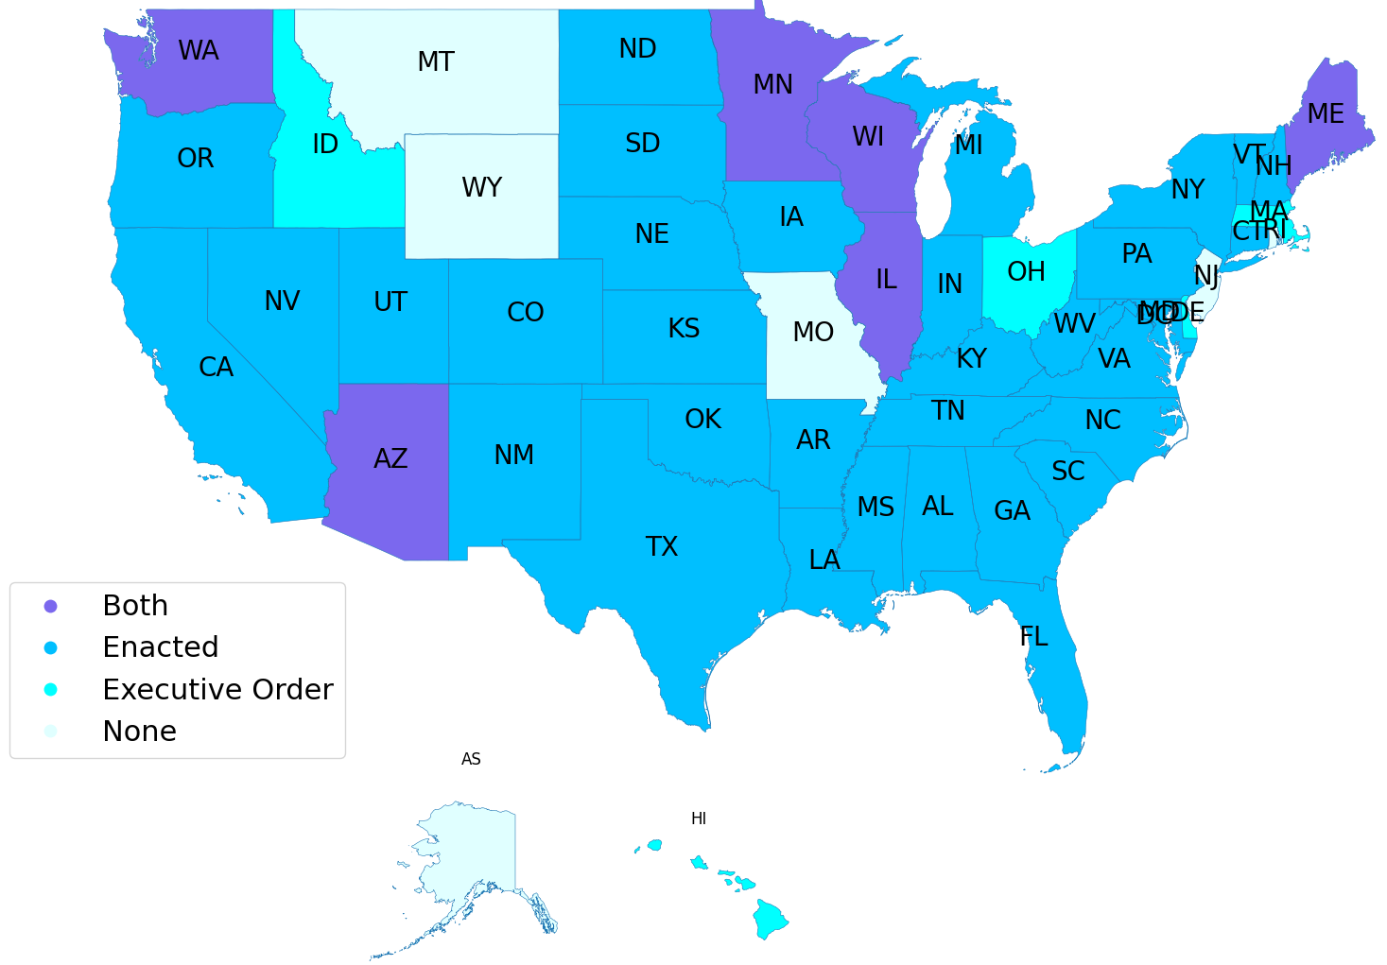
United States—States Legislation
In 2011, Nevada became the first state that allowed testing AVs on public roads and generated the first license for AVs in the United States. Florida became the second state, followed by California. According to the statistics of the National Conference of State Legislatures (NCSL), as of 2024, 39 U.S. along with D.C. have enacted legislation for autonomous vehicles operation or testing, 6 of which enabled both legislation and executive orders. 5 states enacted executive orders only and the rest of 6 states are working on legislation. Alaska, Montana, Wyoming, Missouri, New Jersey, and Rhode Island are lagging behind on AV’s legislation.
States with Automated Vehicles Enacted Legislation and Executive Orders

Slide 17
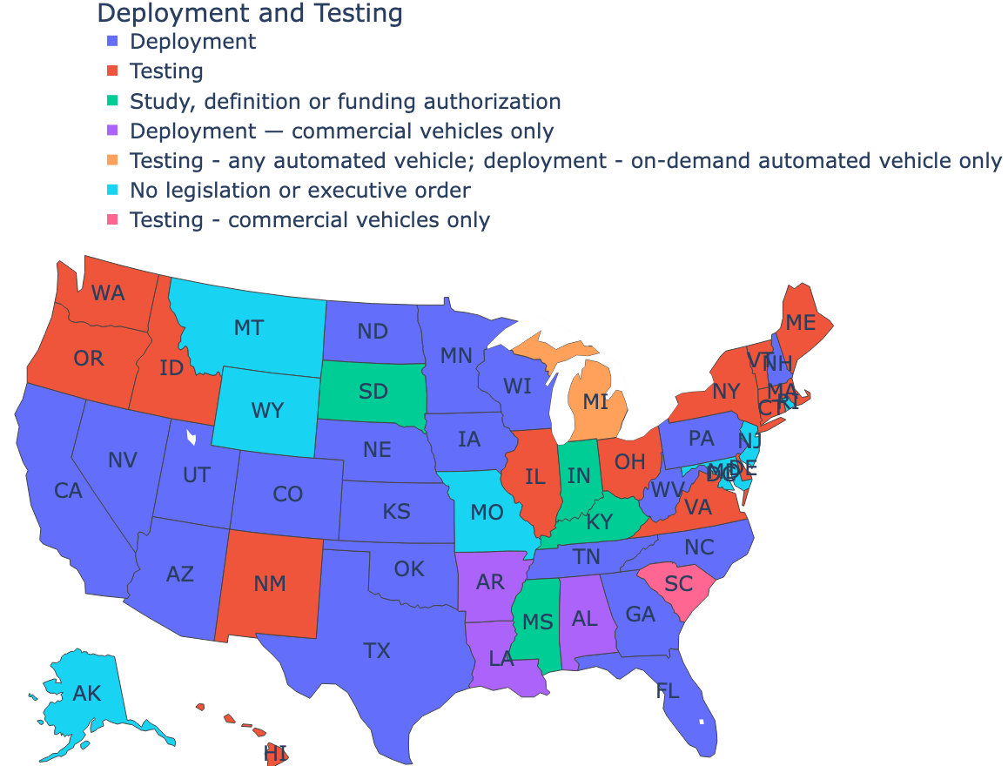
United States—State Legislation for Deployment/Testing
A total of 20 states (purple), to date, have legally allowed the deployment of any automated vehicles on public roads. Three states (blue) allow commercial vehicles only deployed. The state of Michigan enacts the testing of all types of automated vehicles and permits the deployment of on-demand AVs. 15 states along with D.C. enact the testing of all AVs, while South Carolina allows commercial vehicles testing only. Other states such as Indiana, Kentucky and Alaska either are working on legislation or have not started yet.

Slide 18
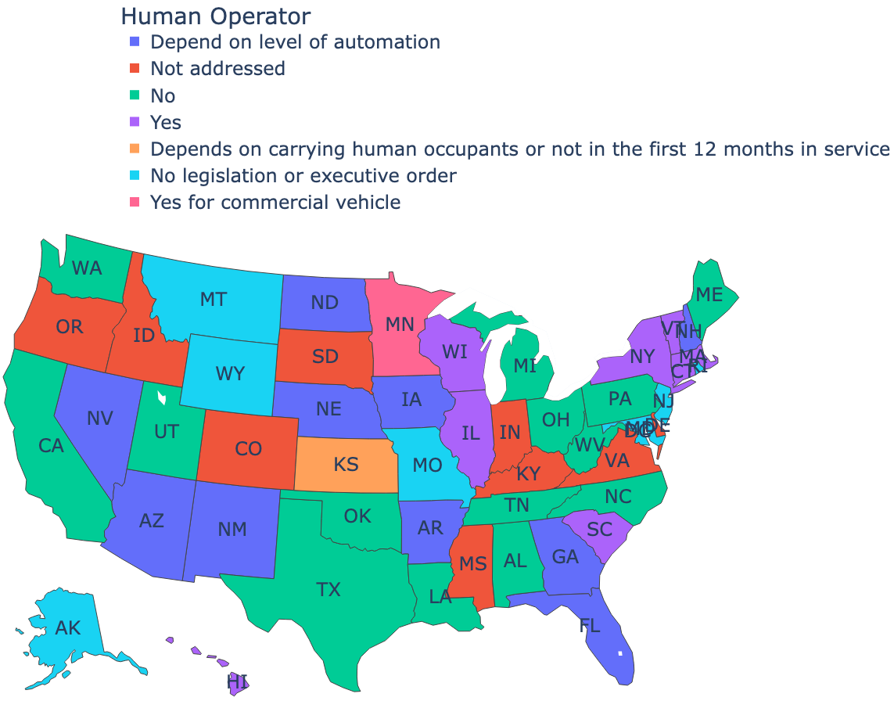
United States— State Legislation for the Request of Human Operators
Around half of the states (including D.C.) either do not require the presence of a human operator or have not legally indicated whether an operator is required or not. The other half proposed legal requirements for the presence of a human operator, yet largely depending on level of automation, whether carrying human occupants, length of service, type of vehicles (commercial vehicles require a human operator but work zone vehicles do not), testing or deployment. Among those, nine states enact a mandate that a human operator must be present in all automated vehicles, no matter whether testing or deployment.

Slide 19
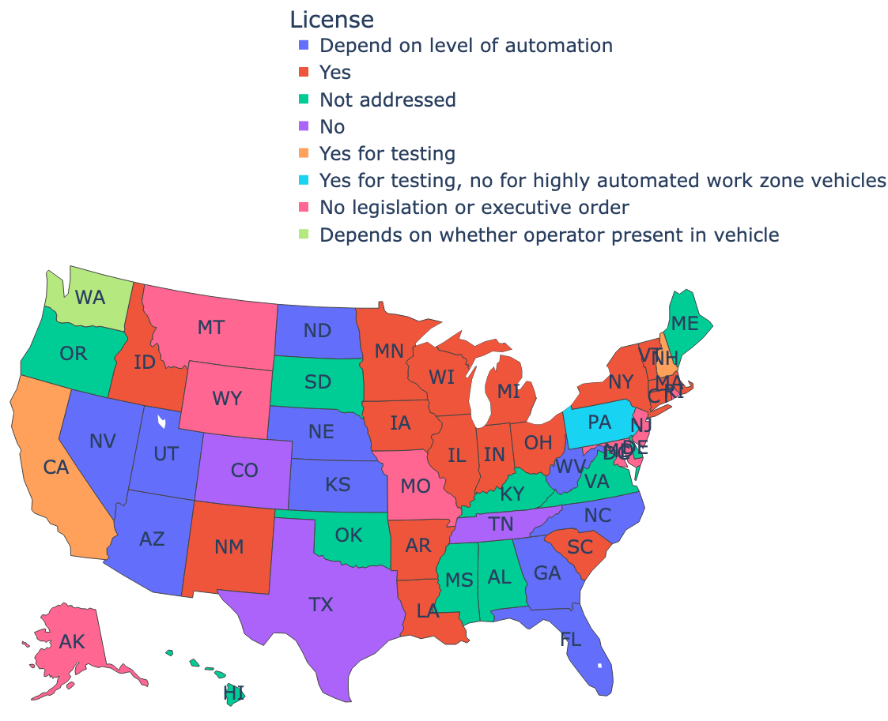
United States— State Legislation for Driver License
With regard to driver license, almost one-third of the states either do not require driver license for automated vehicles or have not addressed the requirement. Among those where driver license is required, half of them are conditional upon level of automation, the presence of a human operator, testing or deployment, type of vehicles (highly automated work zone vehicles do not require operator to have a driver license); the other half (including D.C.) , however, require all operators of any automated vehicles to hold a driver license.

Slide 20
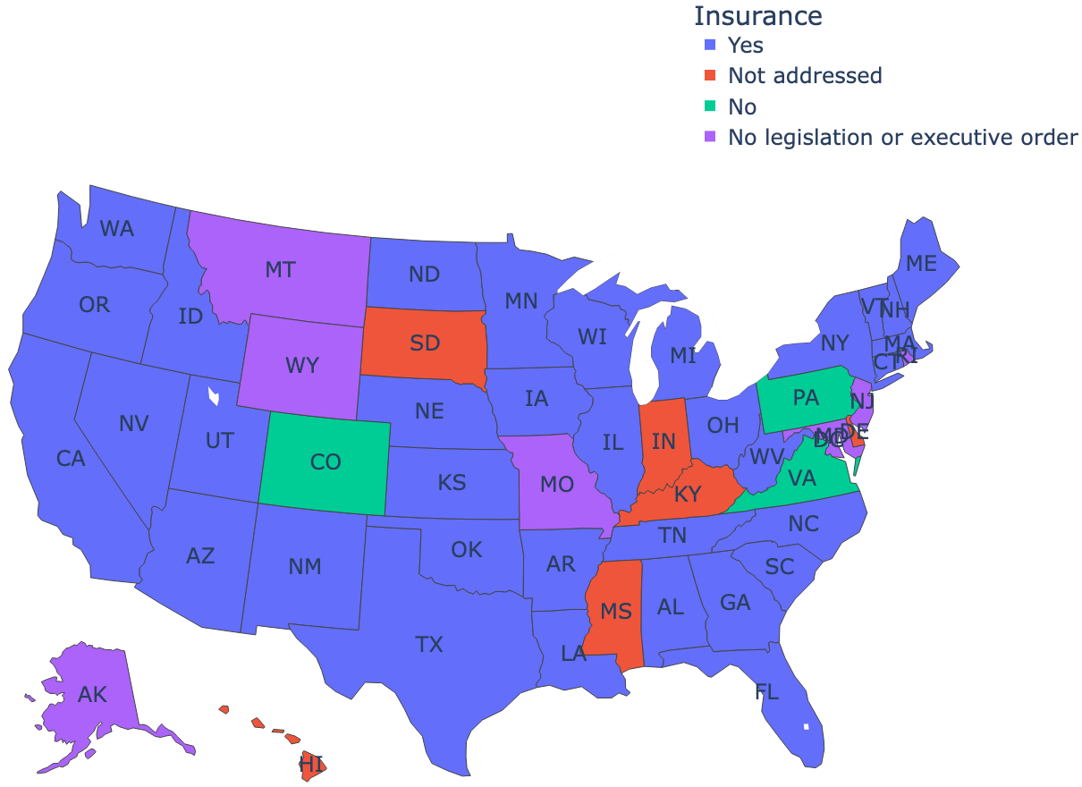
United States— State Legislation for Vehicle Insurance
Most of the states (purple marked) including D.C. require automated vehicles to hold an insurance that clarifies the liability during an accident. Four states, including Colorado, Pennsylvania, Virginia, and Hawaii, currently do not request an insurance. Five states (blue marked) have not addressed whether the insurance is needed or not, and the rest of the states have not legislated for automated vehicles.

Slide 21
China—National Policies
Important national policies for intelligent connected vehicles (ICVs) development
Time | Policy | Key Takeaways | Department
2015 | Made in China 2025 Initiative | CAV is proposed as the key area of intelligent manufacturing for the next 10 years | State Council
2017 | Guidelines for the Construction of National Standards System for Connected Vehicle Industry (ICV) | By 2020, establish standard system for low-level automation (Level 2 and below); by 2025, establish standard system for Level 3 and above | Ministry of Industry and Information Technology (MIIT), State Administration for Market Regulation (SAMR)
2018 | Connected Vehicles (Intelligent Connected Vehicles) Industry Development Initiative | Promote cross-industry collaborative innovation to jointly drive the upgrade of the automotive industry and the transformation of application models, improve the standard system, and continuously increase market share | MIIT
2019 | Outline for Building a Strong Transportation Nation | Enhance R & D in intelligent vehicles, autonomous driving, and vehicle-road coordination, establish a complete industry supply chain | China Communist Party Central Committee (CCPCC) and State Council
2020 | Guidance on promoting the Development and Application of Autonomous Driving Technology in Road Transportation | By 2025, achieve breakthrough in AV fundamental research, road infrastructure intellectualization, and key technology development; deliver important AV-related standards; build national AV testing sites and demonstration programs; realize at-scale deployment in some scenarios | Ministry of Transport

Slide 22
China—National Policies
Important national policies for intelligent connected vehicles (ICVs) development (continued)
Time | Policy | Key Takeaways | Department
2020 | Roadmap for the Development of Intelligent Connected Vehicles (ICVs) Technology in China (2.0) | Propose ICV key technologies and development plan 2035 | MIIT, Ministry of Transport, Ministry of Public Security (MPS)
2021 | Guidelines for the Construction of National Standards System for ICV Industry | By 2025, publish more than 20 standards for intelligent management & services and vehicle-road coordination | Ministry of Industry and Information Technology (MIIT), Ministry of Transport, National Standardization Administration Committee (NSAC)
2021 | Guidelines for Management of ICV Production Enterprises and Products | Stipulate the requirements for the certification of Levels 3 & 4 AV enterprise and products | MIIT
2021 | Regulations for Road Testing and Demonstration Applications of ICV | Regulate pilot testing and demonstration applications of automated driving | MIIT
2021 | Opinions on Accelerating the Construction of a Strong Transportation Nation Driven by Science and Technology Innovation | Propose to develop a new generation of intelligent transportation systems (ITS) with the promotion of automated driving and smart shipping | Ministry of Transport, Ministry of Science and Technology

Slide 23
China—National Policies
Important national policies for intelligent connected vehicles (ICVs) development (continued)
Time | Policy | Key Takeaways | Department
2022 | The 14th Five-Year Plan for Digital Economy Development | Promote intelligent computing to support smart city, smart manufacturing, and autonomous driving | State Council
2022 | 14th Five-Year Plan for the Development of Modern Integrated Transportation System | Encourage AV testing at logistics zone and port; promote smart transit, smart parking; strengthen R&D in ICV, automated driving, vehicle-road coordination, and autonomous ship navigation | State Council
2022 | Guidelines for the Construction of Standards System for Connected Vehicle Network Security and Data Security | Provide the guidance to establish the standards for internet and data security | MIIT
2022 | Guidelines for Autonomous Driving Vehicle Transport Safety Services | Prepare to deploy autonomous shuttles in scenarios such as closed-loop rapid transit systems for urban public transit services | Ministry of Transport
2022 | Notice on Supporting the Construction of Demonstrative Applications for Next-Generation Artificial Intelligence Scenarios | Develop demonstration applications for automated driving in complex conditions such as intersections, roundabouts, and ramps, promote scenarios like unmanned highway logistics, highly automated driving, intelligent connected transit, and autonomous parking | Ministry of Science and Technology

Slide 24
China—National Policies
Important national policies for intelligent connected vehicles (ICVs) development (continued)
Time | Policy | Key Takeaways | Department
2023 | Construction of Standard System for Intelligent Vehicle Basic Mapping | By the end of 2025, develop preliminary ICV basic mapping standards that is able to support autonomous driving applications | Ministry of National Resources
2023 | Guidelines for Establishing the National Standards for the ICV Industry | Propose to establish ICV standards step by step that adapts to China’s national conditions while at the same time align with international standards | MIIT, NSAC
2023 | Notice on Level 3 and Level 4 ICVs Testing Permission and On-Road Testing | The first policy in China that supports Levels 3 and 4 ICVs road testing, which allows Levels 3 and 4 testing in closed-loop areas | MIIT, MPS, Ministry of Transport, Ministry of Housing and Urban-Rural Development (MHURD)
2023 | Guidelines for Autonomous Driving Transport Safety Services | Regulate AV’s application scope and scenarios, vehicles, human operators staffing, security guarantee, and safety monitor | Ministry of Transport
2023 | “Data Element X” Three-Year Initiative (2024-2026) | Support autonomous vehicle commercial operations in specific areas and time, break barriers between data suppliers such as auto makers, 3rd parties, and transport enterprises, promote multi-source data fusion and improve ICV innovative services and proactive safety | National Development and Reform Commission (NDRC)

Slide 25
Automated Vehicle R & D and Market Assessment
This section will introduce the market situation of automated vehicle (AV) development covering the following areas:
R & D activities
AV testing and major players in the United States
AV market size and penetration rate

Slide 26
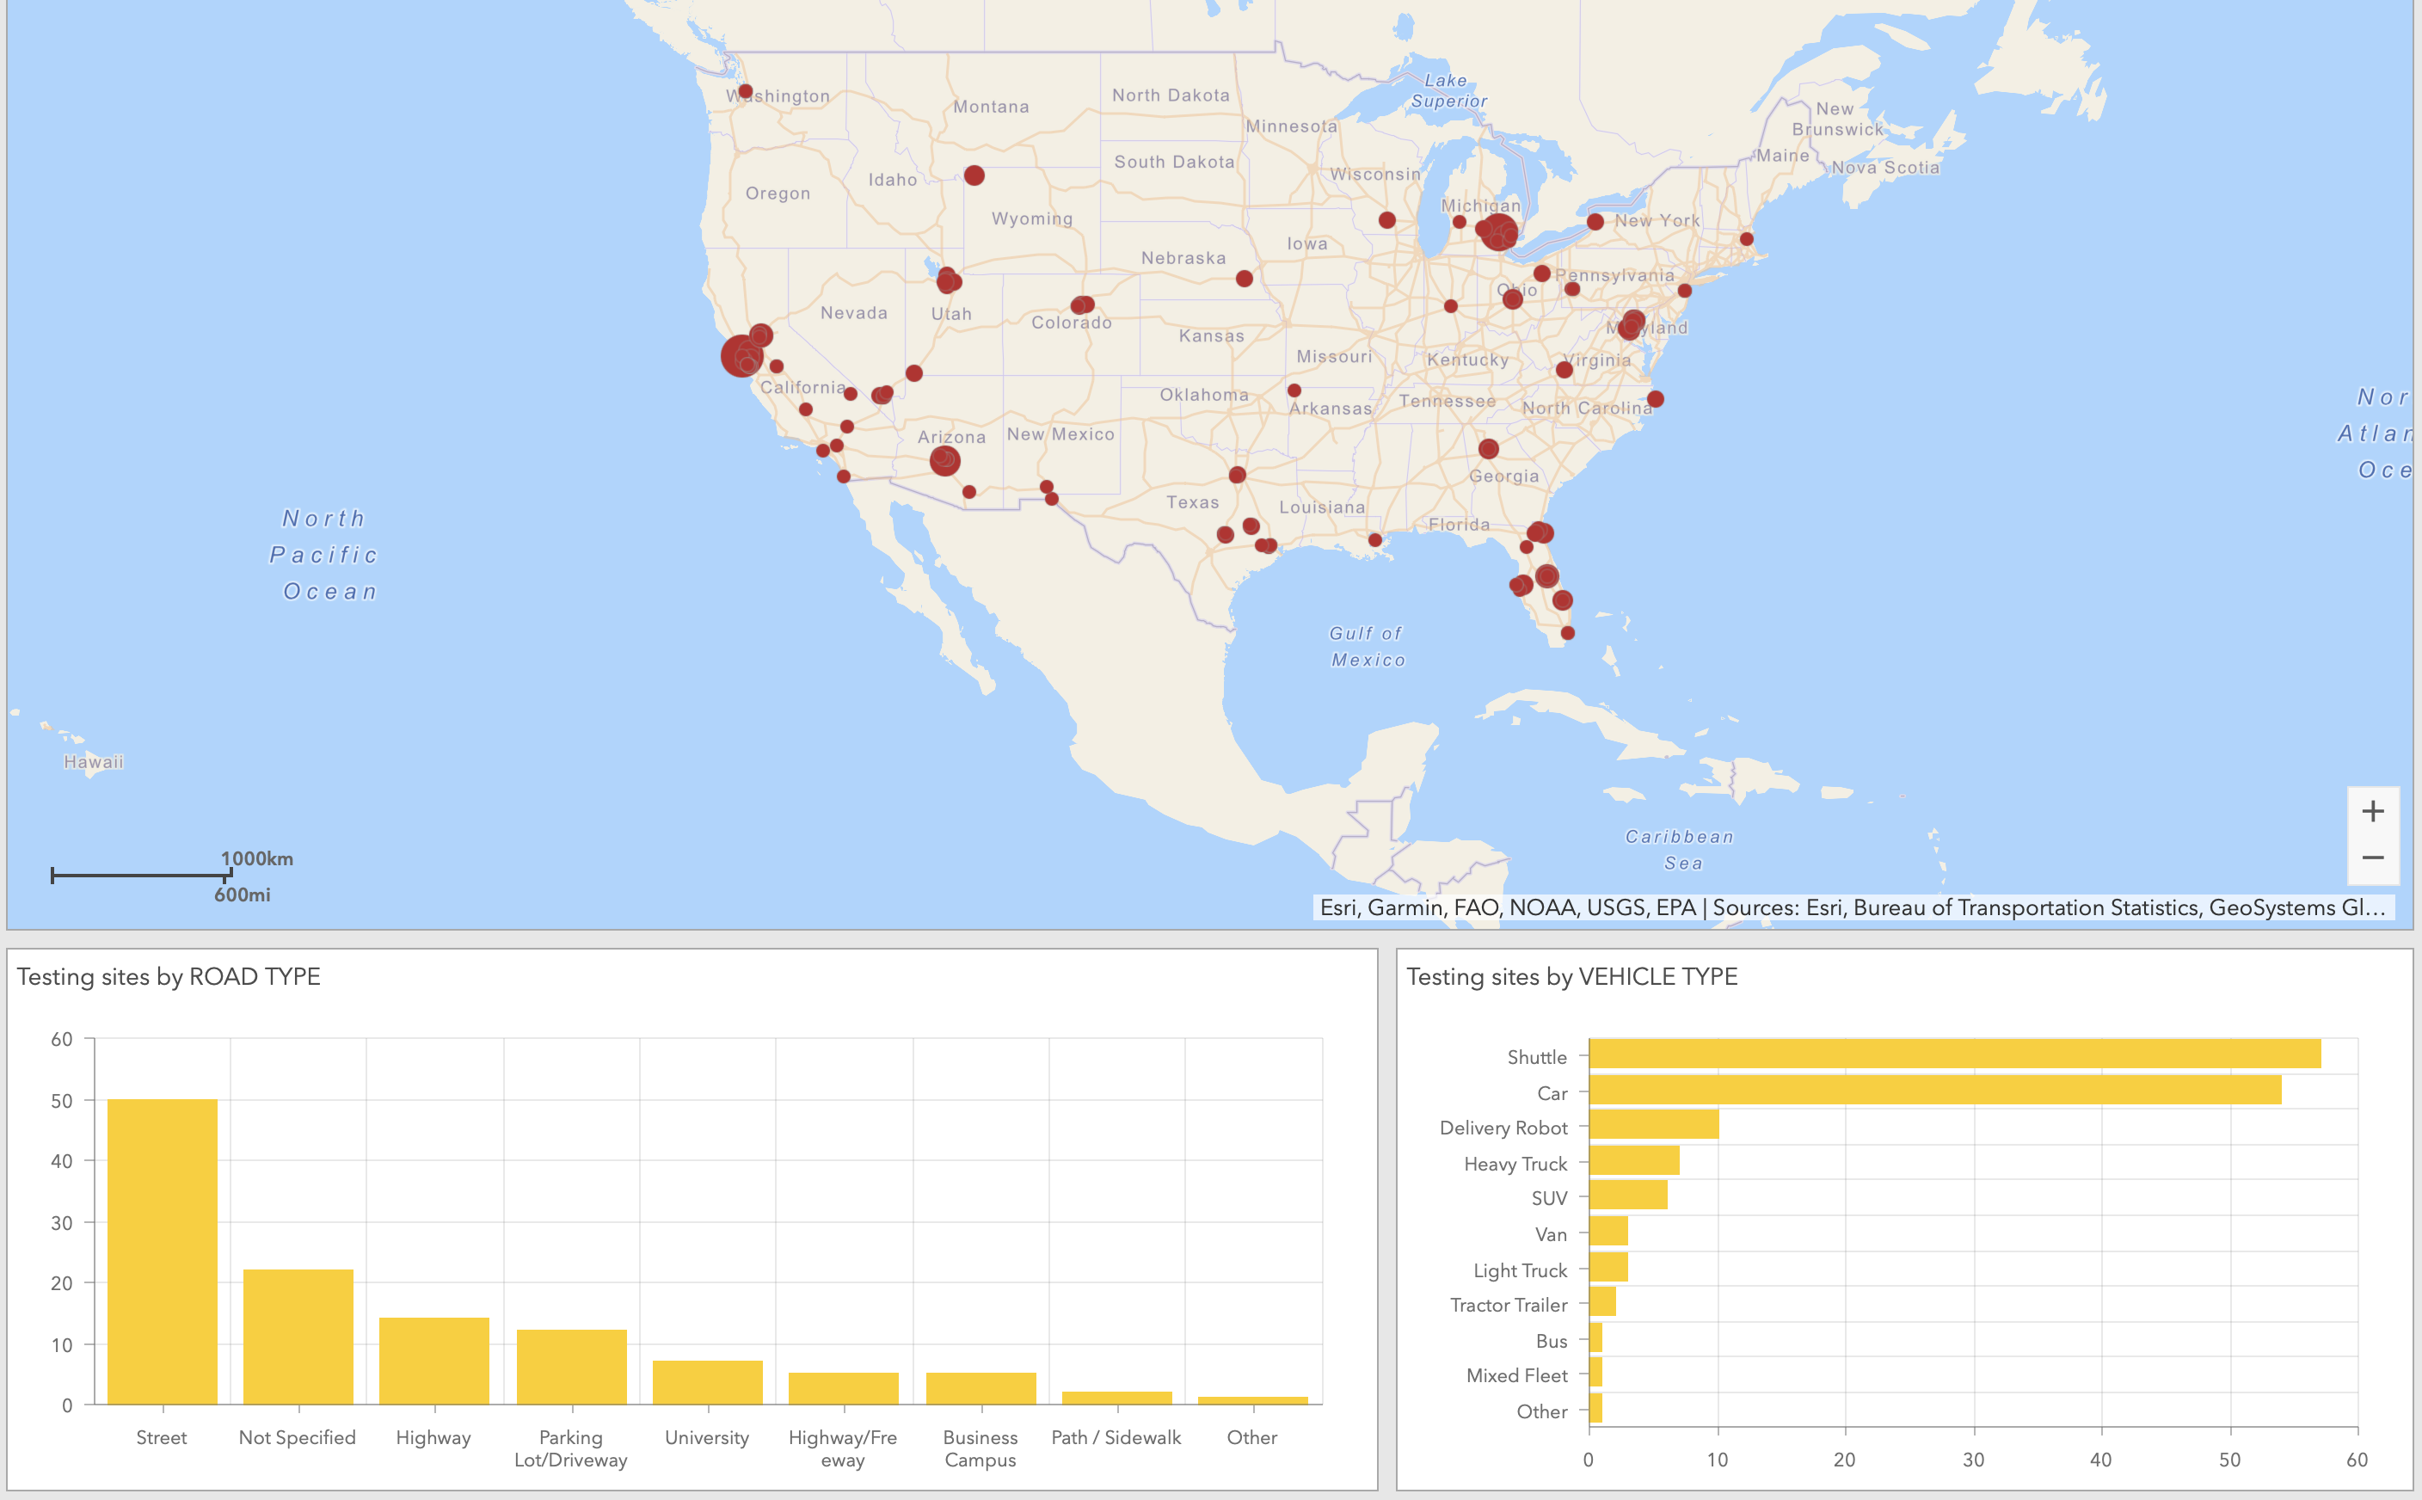
Automated Vehicle Testing Activities in the United States
Automated driving players test their technologies and systems on public roads and voluntarily submit information about the testing to National Highway Traffic Safety Administration (NHTSA). NHTSA demonstrates that testing sites are distributed throughout the United States, with more tests completed in California, Michigan, Arizona, Florida, and D.C. (larger red dots in the figure below indicate higher number of vehicles being tested at that location). The most testing road is urban street. Other sites include highway, parking lot and driveway, university campus, freeway, business campus, sidewalk, rural road, and others. Shuttles and passenger cars were most tested, followed by delivery robot, heavy duty truck, SUV, Van, light duty truck, tractor trailer, bus, and mixed fleet.
Data Source: NHTSA

Slide 27
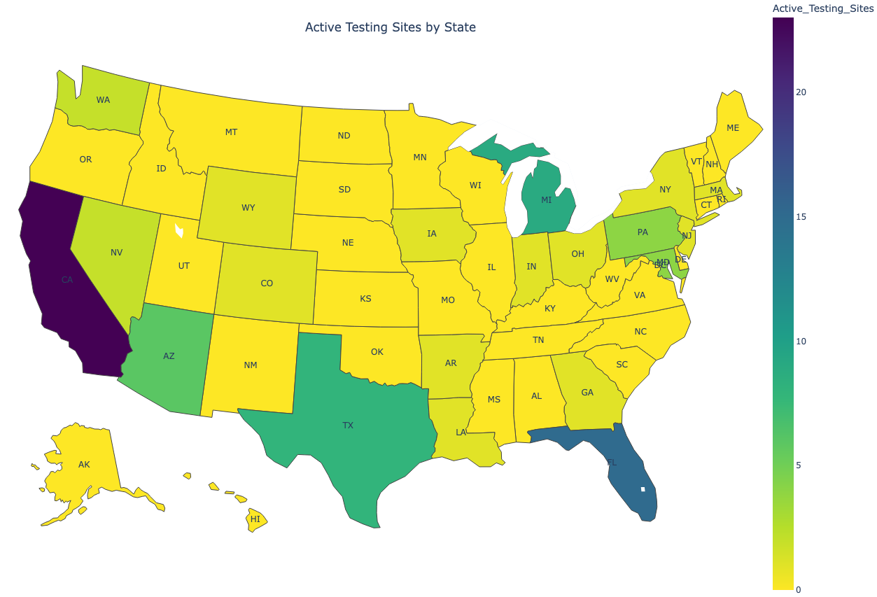
Number of Active Testing Sites by State
The NHTSA summarized the number of automated vehicle active testing sites across the country. It turns out that California has the most testing sites, followed by Florida, Michigan, Texas, Arizona, and D.C.. Many auto makers, tech companies, and AV start-ups are headquartered or have subsidiaries in those regions, which enables AV development much faster than other states. NHTSA has not received any testing report from 30+ states (yellow marked).
Data Source: NHTSA

Slide 28
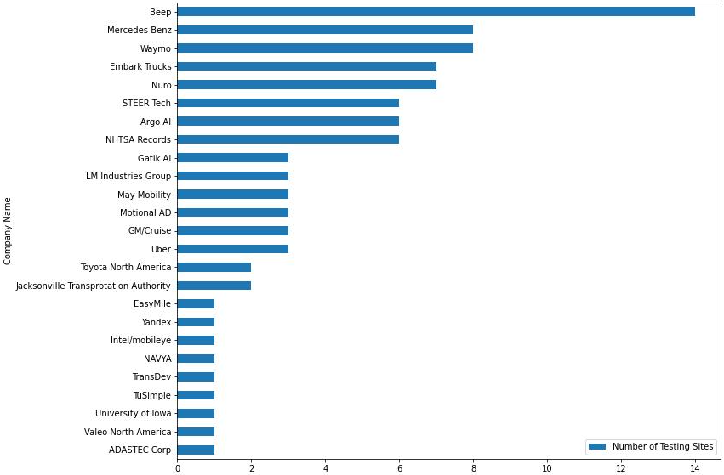
Number of Active Testing Sites by Company
Distributed by company, Beep has tested automated vehicles at 14 sites which are the most, followed by Mercedes-Benz, Waymo, Embark Trucks, Nuro, and many others. It should be noted that, however, higher number of testing sites does not necessarily mean more testing vehicles, higher number of tests, and more advanced AV technologies of the company. The amount of tests and robustness of the technology will be discussed in later slides. This slide only briefly describes the distribution of the number of testing sites across companies.
Data Source: NHTSA

Slide 29
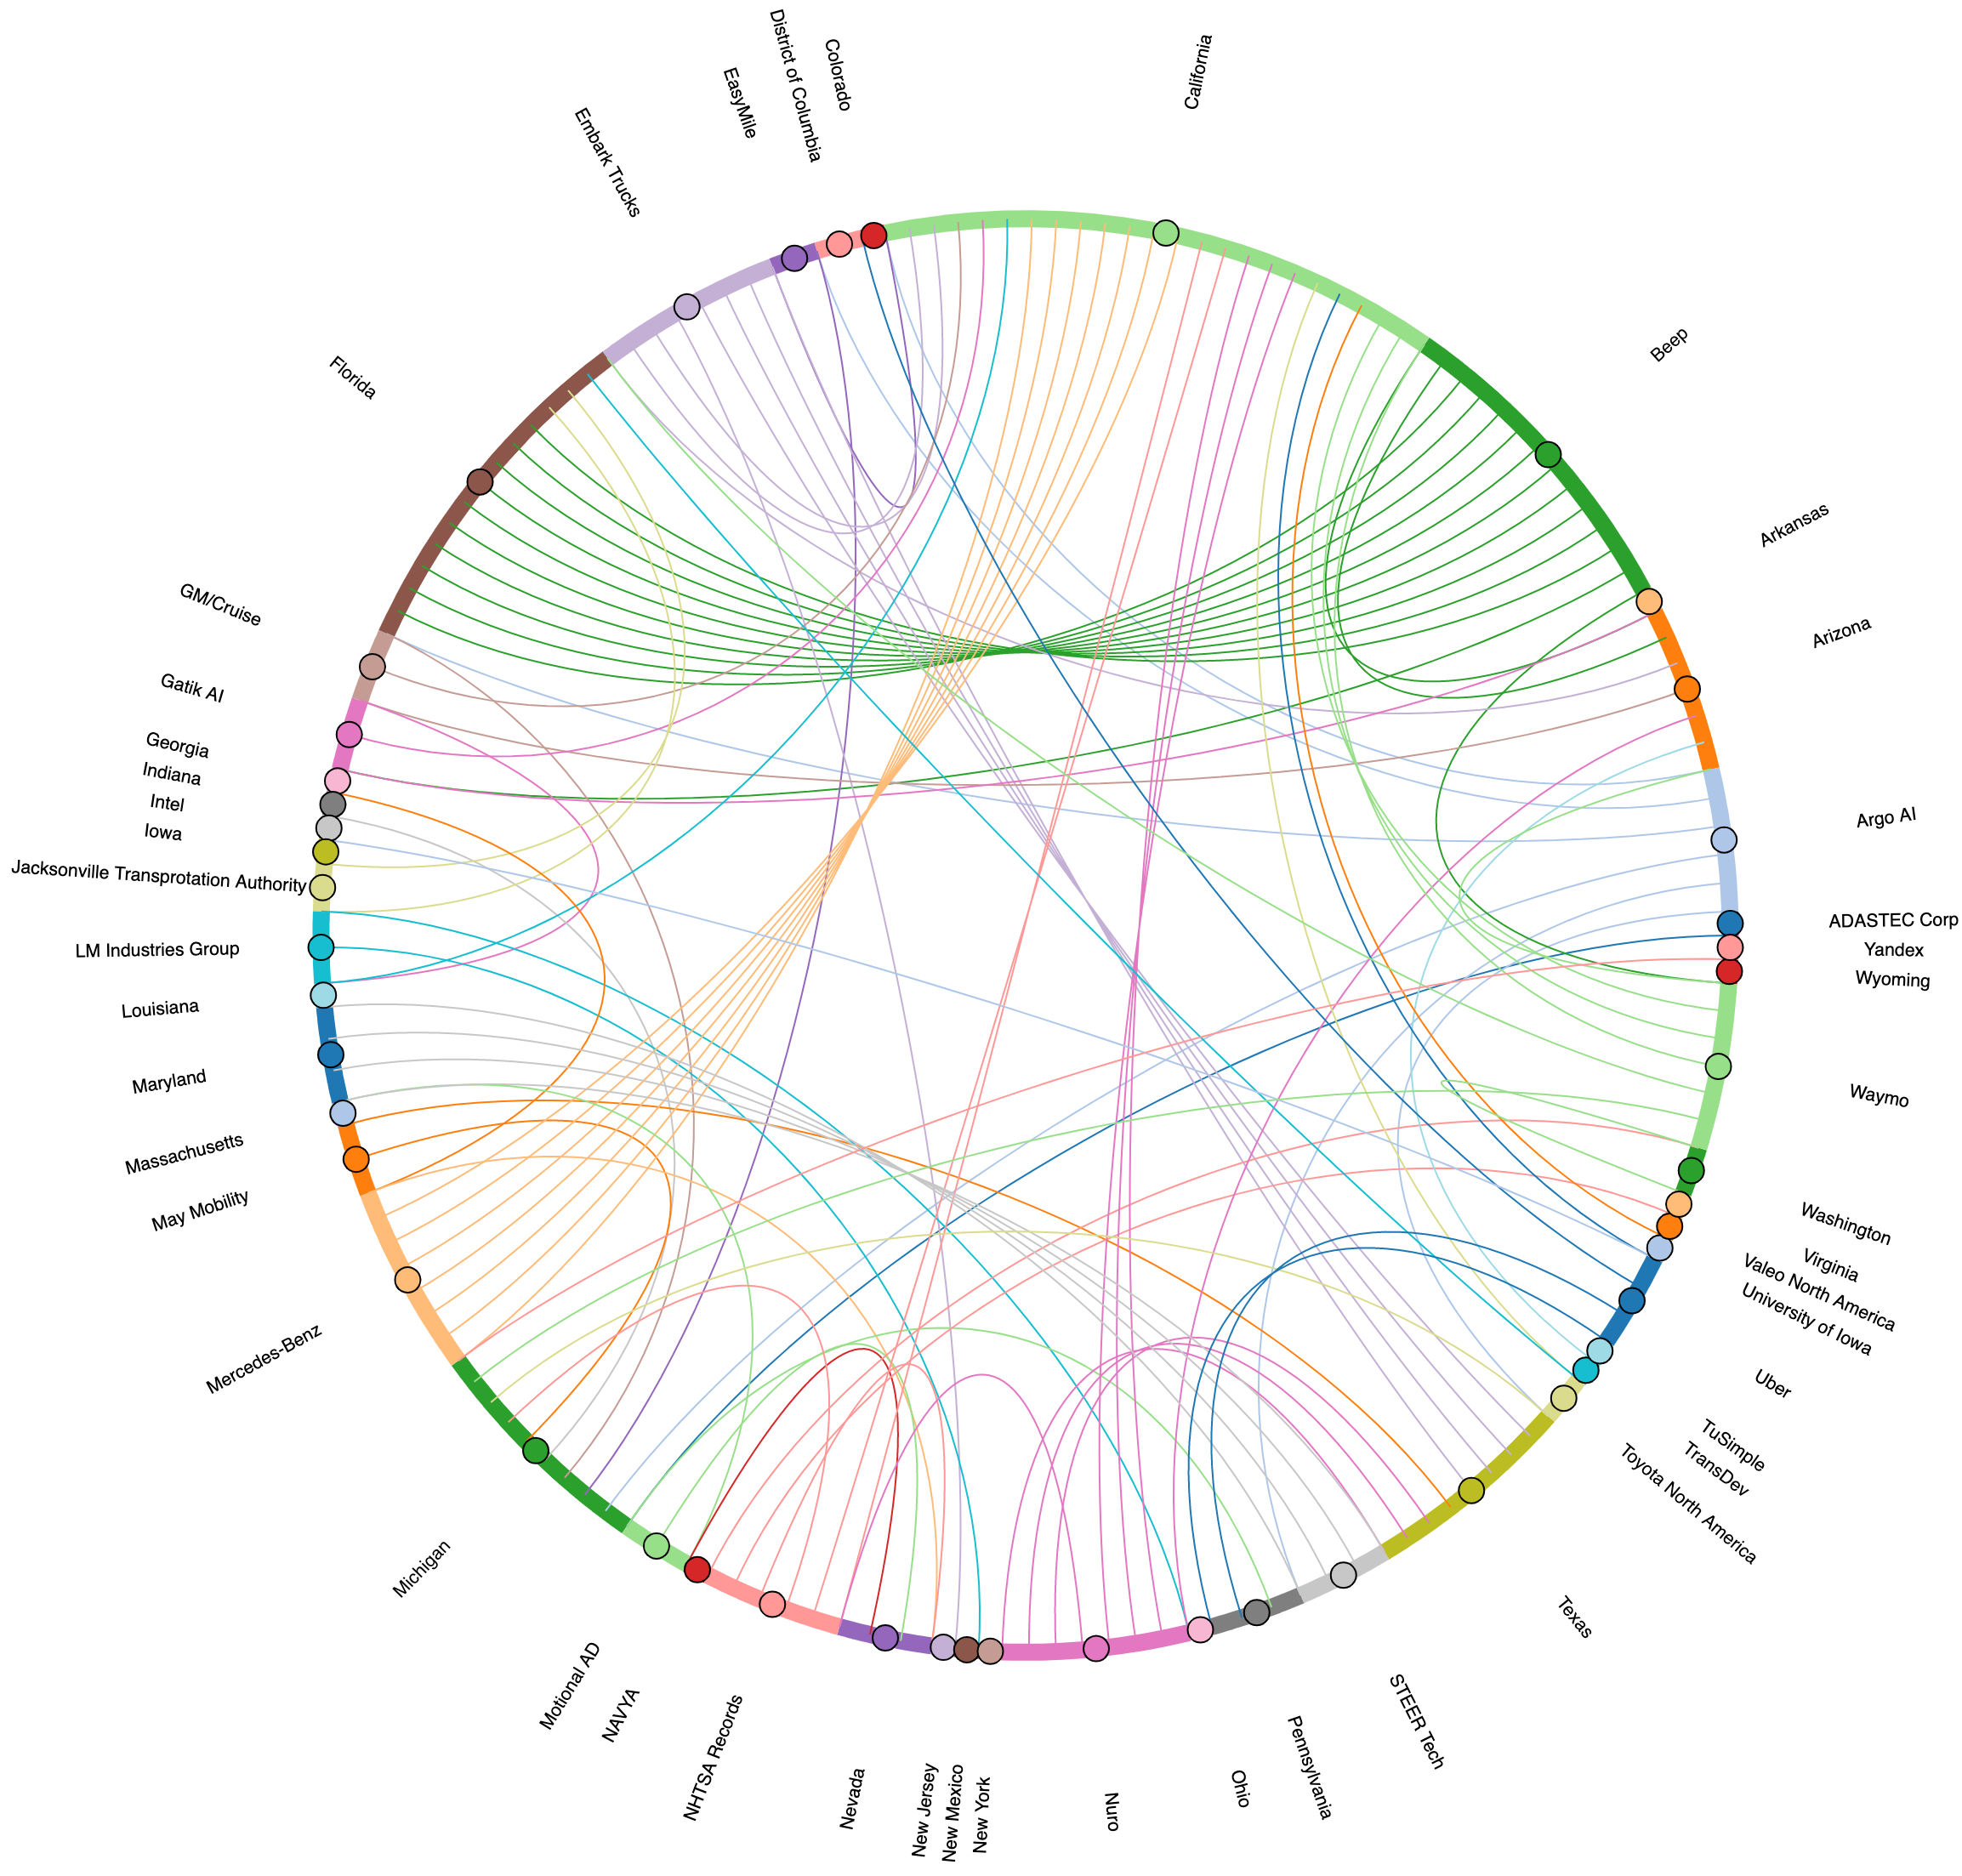
State Distribution of Company Testing Sites
The interactive mode of the diagram is provided here:
file:///Volumes/work/Projects/AV%20Outlook%20US/scripts/company-states.html

Slide 30
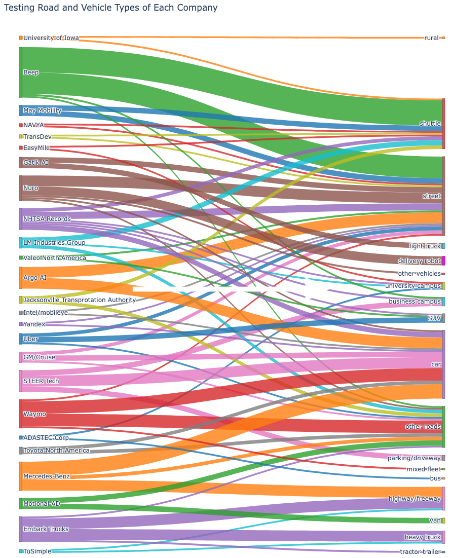
Company Testing Road and Vehicle Types

Slide 31
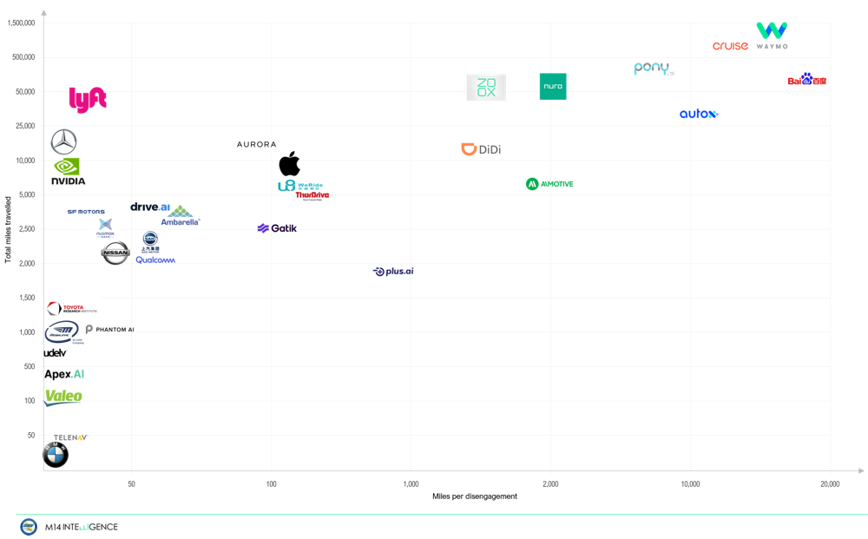
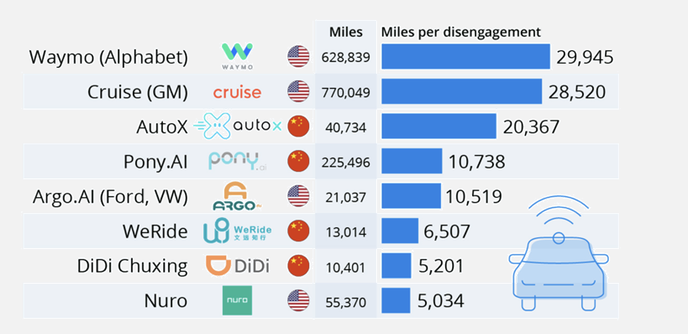
Automated Vehicle Technology Development Race
-Total miles travelled vs. Miles per Disengagement recorded in California in 2021 by DMV, compared to 2019, 2020
2019
2020
Data Source: California DMV

Slide 32
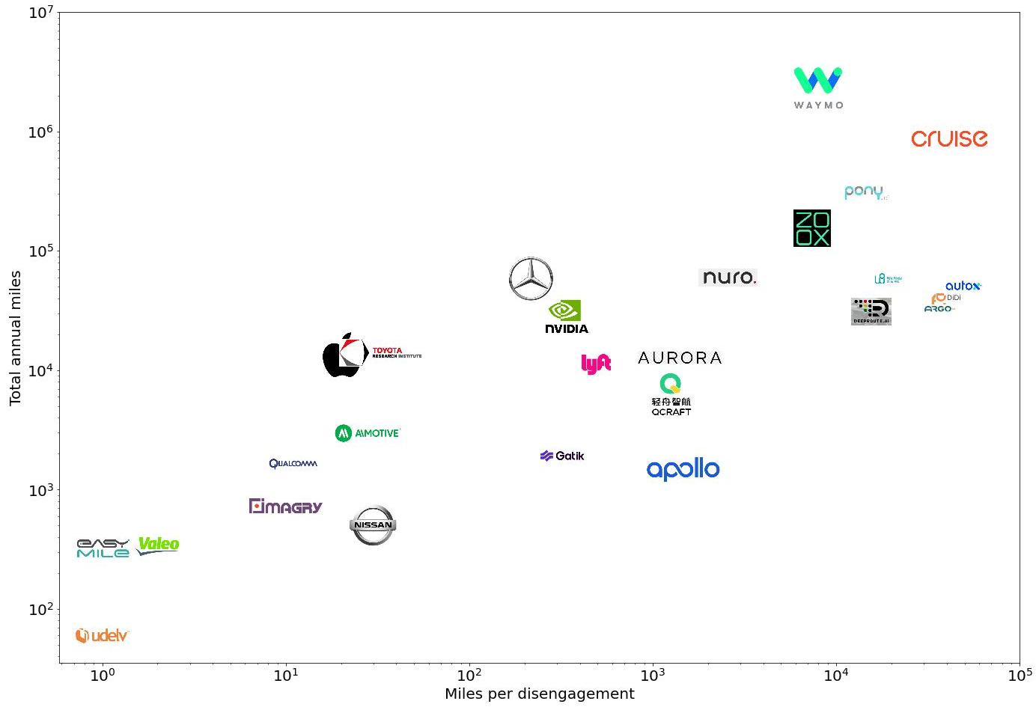
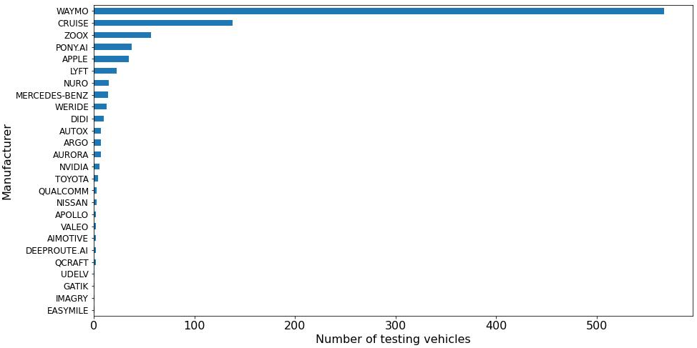
Automated Vehicle Technology Development Race
-Total miles travelled vs. Miles per Disengagement recorded in California in 2021 by DMV, compared to 2019, 2020
2021
Data Source: California DMV

Slide 33

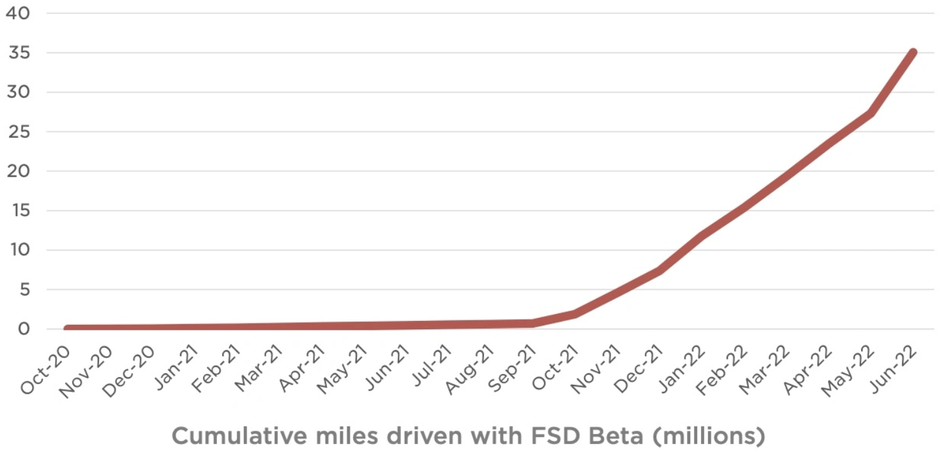
Automated Vehicle Technology Development Race
-Tesla Testing Mileage
Tesla has published how many miles have been driven by people using Full Self-Driving (FSD) Beta, revealing for the first time in their Q2 2022 financial report they have now hit 35 million cumulative miles (58M km) as of June 2022. This is a huge overall numbers and points towards a massive user base using FSD Beta which Tesla says is now over 100,000 in the United States and Canada. Between October 2020, when the first FSD Beta trials launched, and November 2021, the numbers for cumulative miles were under 5 million only. This means that the number of miles has gone from 5 million to over 35 million in six months with the expansion of FSD Beta to Canada and to more users in the US. This number is extremely higher than other autonomous driving companies. Among others, Waymo has the most testing mileage, hitting 2.3 million miles in 2021 which is much higher than other competitors like Cruise and a huge improvement compared to it was in 2020. Tesla obviously is far ahead of others in terms of testing miles for AV development. As of April 2022, there were over 100,000 drivers taking part in FSD Beta program, and this number continues to grow. This demonstrates that 35 million is only going to be a starting point, much more cumulative miles would be completed.
However, Tesla did not publicly report the disengagement rate, which is hard to know how many miles could be driven without human interventions. Also, the responsibility lies with the driver rather than Tesla’s system, it is still considered a level 2 driver assistance system despite its name FSD. But it is the closest thing to a self-driving vehicle that is available to customers instead of a closed fleet operated by companies like Waymo and Cruise.

Slide 34
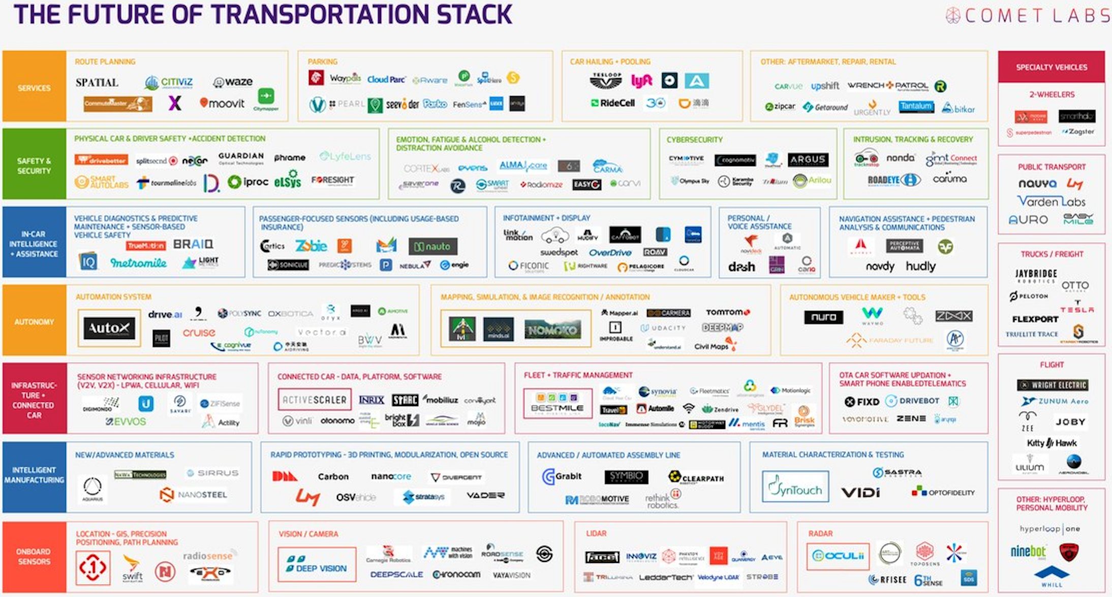
Automated Vehicle Technology Development Race
-Major players of automated driving—from the fund-raise perspective
Source: Comet Labs (A venture capital fund and startup platform, founded in 2015)
Funding amount in billion U.S. dollars
It is not clear about the exact number of all AV companies, but the COMET Labs summarized the majority of them and classifies them into 7 categories, including those providing AV-related mobility services, developing autonomous systems, designing in-car intelligent assistance devices, improving safety and security, manufacturing onboard sensors and connected devices. Based on the fund raise amount only (results come from Statista), Cruise and Waymo perform the best as of April 2022. Other major players include Argo AI, Momenta, Pony, Nuro, Aurora, WeRide, and so forth. It should be mentioned that Tesla is mostly funded internally and thus not analyzed here.
Data Source: Statista

Slide 35












Automated Vehicle Technology Development Race
-Major players of automated driving—from the perspective of market value
Eight top automated driving stocks in 2022, data source: YCharts.
COMPANY | Logo | MARKET CAPITALIZATION | DESCRIPTION
Alphabet |  | $1.5 trillion | Parent of Google and leading self-driving car start-up Waymo.
Amazon |  | $1.2 trillion | Owner of Robotaxi start-up Zoox.
Tesla |  | $783 billion | Lead Autopilot and Full Self-Driving (FSD) autonomous driving programs.
Nvidia |  | $456 billion | Semiconductor design leader turned AI platform including a product family for self-driving cars.
Qualcomm |  | $156 billion | The smartphone and mobility chip leader building products and software for the auto industry.
Micron Technology |  | $83 billion | Top memory chipmaker getting a massive lift from vehicle technology.
General Motors |  | $55 billion | Legacy automaker and owner of start-up Cruise.
Ford |  | $54 billion | Another legacy automaker, top pickup truck maker, and autonomous vehicle investor, the major investor of Argo AI
Argo AI disbanded in October 2022

Slide 36






Automated Vehicle Technology Development Race
-Major players of automated driving—from the perspective of commercial advancement in driverless mobility services
Company Logo | Description
 | Waymo launched its commercial autonomous vehicles in 2018 and opened the first driverless taxi service to the public in 2020 in Phoenix. In March 2022, Waymo expanded the service to San Francisco starting with driverless rides for Waymo employees. The company also plans to expand commercialization to multiple geographies. Waymo and Uber Freight initiated collaboration in June 2022 to launch future self-driving trucks.
 | GM Cruise won the first California permit to carry paying riders in driverless cars and launched its first driverless taxi service in San Francisco Feb. 2022. As of August 2022, Cruise has completed 250,000 driverless miles after giving thousands of driverless rides in San Francisco. The company also plans to produce autonomous all-electric shuttle since 2023.
 | Baidu rolled out Apollo Go in Shenzhen Feb 2022 and got permits for the first driverless taxi service in China. It received the regulatory approvals for autonomous ride-hailing service Apollo Go to operate on open roads during daytime in Chongqing and Wuhan.
 | In October 2020, Tesla launched its self-driving taxi service named Full Self-Driving (FSD) beta. As of August 2022, FSD has achieved 40 million driving miles. A key difference with Tesla is that most other autonomous taxis only operate on pre-mapped streets in set geographies; whereas Tesla FSD drivers can go anywhere provided the car's cameras can see. Tesla confirmed that they are planning a dedicated RoboTaxi which would be without steering wheel and pedals and produced in 2024.
 | Hyundai and Aptiv jointly develop the Motional program to launch a new Robotaxi service which provides free self-driving rides to passengers in downtown Las Vegas, Nevada. The services are now available on the Via app for passengers in downtown Las Vegas and connect riders with business hubs, residential buildings, green spaces, government buildings, public transit stations and more.
 | In 2022, Pony announced its first autonomous taxi service which has been awarded a permit to operate 100 autonomous vehicles as traditional taxis in Nansha, Guangzhou, China. Passengers can be provided with ride-hailing services with payment. Robotaxi operates from 8:30 am to 10:30 pm and fares based on standard taxi pricing in Guanzhou. Pony currently retains a safety driver. Pony plans to expand its commercialization to Shanghai and Shenzhen in 2023 and to more cities in 2024 and 2025.

Slide 37
Automated Vehicle Technology Development Race
-Major players of automated driving—likely to be abandoned
Many of the unicorn autonomous driving companies have their valuations drop dramatically compared to the valuation at IPO over the past year. We here provide a Crunchbase analysis of the valuations of 14 AV companies all of which have high market values at IPO yet drop dramatically today. On average, these companies have 81% percent of value decline with the most drop 99% and 97% respectively for Quanergy Systems, Embark and Otonomo. The big jump of the values is most likely because investments return rationality. Investors rushed to put money in the market in order to gain the opportunities in future-shaping technologies like autonomous driving. Yet, after years of no expected return, investors realize money should go where it is worth going. Those without advanced technologies and productivity will of course be given up. The decrease of valuation of those companies does not mean AV development suspends or declines but demonstrates a more rational market ahead. The fittest will survive. Therefore, the market value (IPO) should not be the only measurement of the competitiveness of an AV company, rather, technology advancement and productivity are more important.
Public Market Performance of Funded Companies Tied to Automated Driving Technologies
Company | VALUATION AT IPO | VALUATION TODAY | VALUATION TODAY % CHANGE
Aurora | 14000M | 2611M | -81%
TuSimple | 8500M | 1516M | -82%
Luminar | 7000M | 2453M | -65%
Embark Technology | 5160M | 141M | -97%
Velodyne Lidar | 4000M | 202M | -95%
Aeva | 2100M | 435M | -79%
AEye | 2000M | 178M | -91%
Ouster | 1900M | 148M | -92%
Innoviz | 1400M | 655M | -53%
Cepton | 1400M | 370M | -74%
Otonomo | 1400M | 40M | -97%
Quanergy Systems | 1100M | 16M | -99%
Arbe | 722M | 361M | -50%
CYNGN | 198M | 32M | -84%
Total | 50880M | 9158M | -81%
Source: https://news.crunchbase.com/transportation/self-driving-tech-startups-funding-ipos/

Slide 38
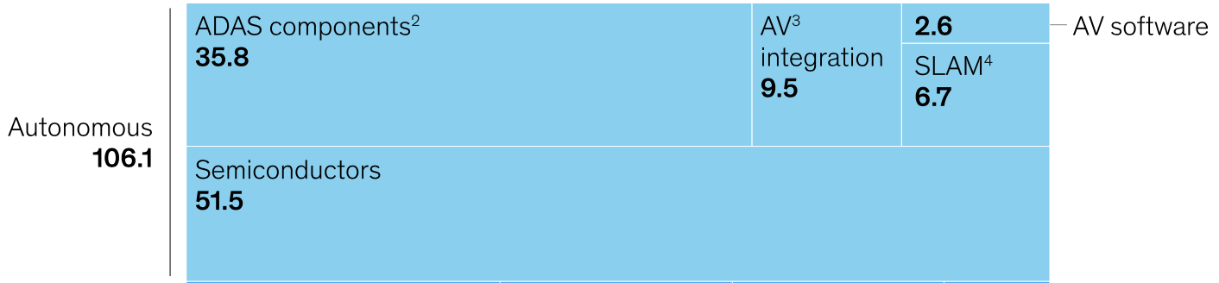
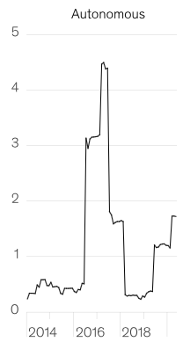
Investment in Automated Driving Technologies
Over the past decades, automated driving has been made big progress with the advancement of sensing, computer vision, and chip technologies benefiting from the huge amount of financial supports from a variety of social entities such as information technology companies, traditional automakers, venture capitalists, and government. McKinsey reported that, from 2010 to 2020, a total of approximately 106 billion USD were poured globally in developing automated driving technologies which are classified into five clusters, including semiconductor, advanced driver assistance systems (ADAS), automated vehicle (AV) integration, simultaneous localization and mapping (SLAM), and automated vehicle software. Among those clusters, semiconductors obtained the largest amount of capitals with a total of 51.5 billion USD, followed by ADAS 35.8 billion USD, AV integration 9.5 billion USD, SLAM 6.7 billion USD, and lastly AV software 2.6 billion USD.
(Billion USD)
Source: McKinsey Mobility’s future: An investment reality check
Semiconductor and ADAS components are the two largest investing clusters which gradually lost traction after 2017. This resulted in the significant drop of investment in AV development. However, interest of AV has been risen again since mid-2019. New avenues are emerging for growth in autonomous vehicles. While overall investment growth has flattened, some company clusters that had previously attracted relatively little interest have recently gained traction. When looking at investments from 2018 onward, compared with the period from 2014 to 2017, the most dramatic increases have occurred in companies involved with AV integration (a fourfold increase), AV software (threefold), micro-mobility (fourfold), and car sharing (seven- to eightfold). Obviously, investors have shifted funds from developing hardware technologies to software and system integration as well as mobility applications.
Global Investment Amount (Billion USD)
Source: McKinsey Mobility’s future: An investment reality check

Slide 39
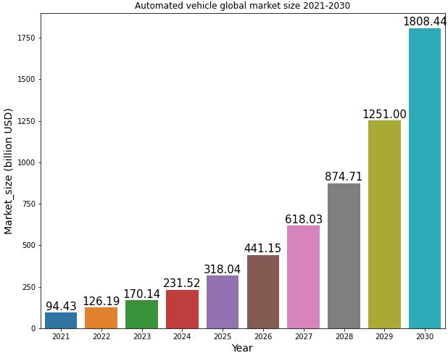
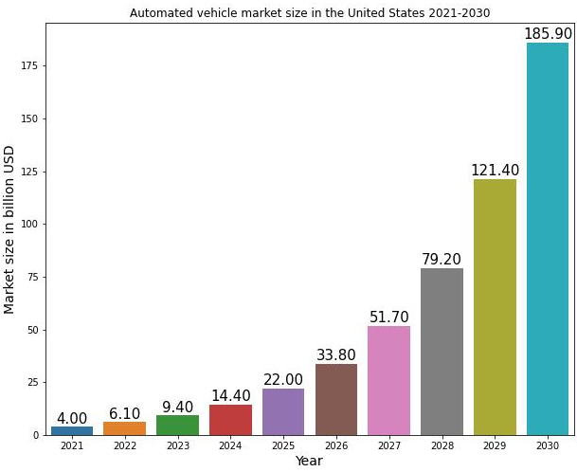
Market Size of Automated Vehicle
Global Market
According to Precedence Research, the global automated vehicle market was estimated at 94.43 billion dollars in 2021 and is projected to hit approximately 1808.44 billion dollars by 2030, with a compound annual growth rate (CAGR) of 38.8% from 2021 to 2030.
Data Source: https://www.precedenceresearch.com/autonomous-vehicle-market
U.S. Market
U.S. automated vehicle market was estimated at 4 billion dollars in 2021 and will reach approximately USD 185.9 billion by 2030, with a compound annual growth rate (CAGR) of 53.2% from 2021 to 2030. As the global leader in technology, American ingenuity and innovation have historically transformed how they travel and connect. Under this administration, Americans will continue leadership in emerging technologies, including automated driving.
Data Source: United States Autonomous Vehicles Market, Size, Forecast 2021-2030, Industry Trends, Growth, Impact of COVID-19, Opportunity Company Analysis, https://www.researchandmarkets.com/reports/5576804/united-states-autonomous-vehicles-market-size#src-pos-3

Slide 40
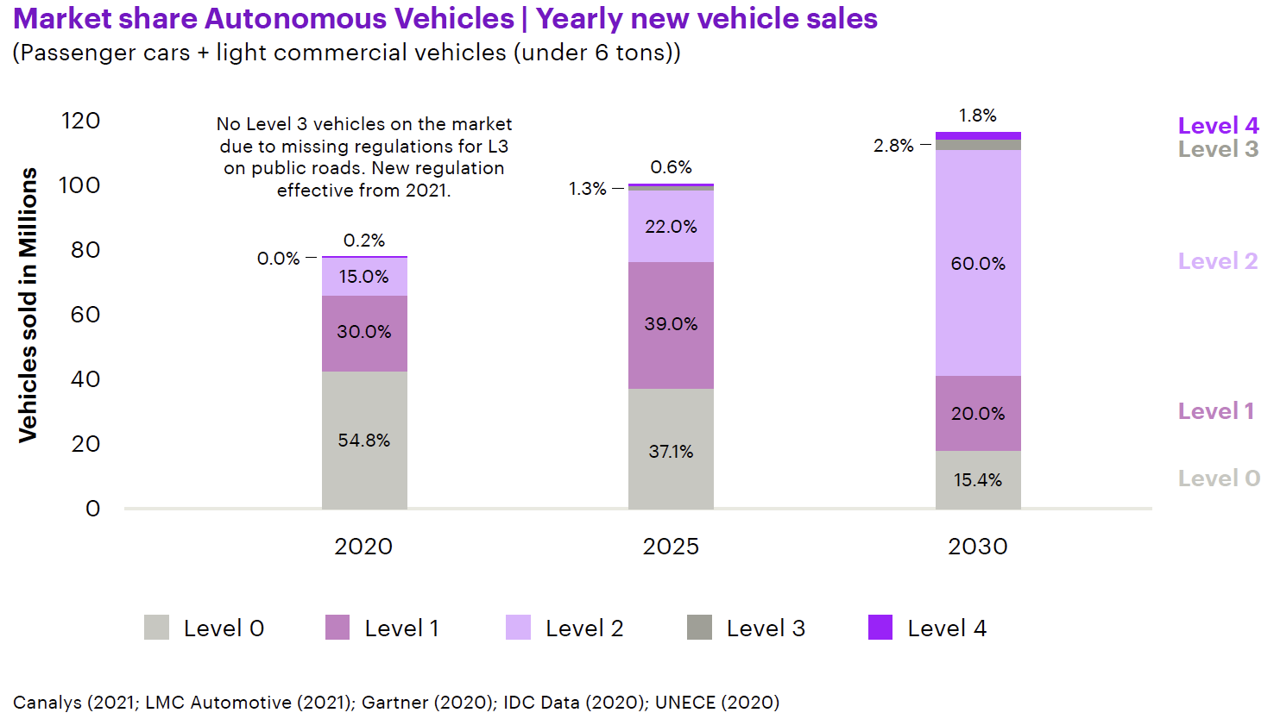
New Sales of Automated Vehicle
The continuing investment and technologies advancement have enabled the increase of automated vehicle testing and deployment. Accenture reported that, in 2020, 45% of the new sale vehicles were equipped with ADAS features with 30% for Level 1 automation and 15% for Level 2 automation. Only a small percentage (0.2%) of luxury vehicles were at the Level 3. It is predicted that, in 2025, the share of Levels 1 and 2 vehicles will hit to 39% for Level 1 and 22% for Level 2 respectively, with 1.3% for Level 3 and only 0.6% for Level 4. By 2030, the vehicles with low level of automation (Level 1 and Level 2) will dominate the market with a total market share of 80%, yet Level 3+ still accounts for a small market size with 2.8% for Level 3 and 1.8% for Level 4. The low sales for Level 3+ is because high automation functionalities will be largely restricted to the highest premium vehicles which have a very small market share. Also, Level 3 or 4 is hard to be achieved in high degrees of complexity such as high speed. Technology advancement requires a big step forward to enable wide deployment of partial and high automation. According to Accenture, beyond 2030, advanced technologies will spread into lower market segments, helping commoditize the respective hardware and software technologies. Full automation (Level 5), however, is not anticipated to hit the market within the next ten years given its extremely high requirements in security and reliability of technologies and algorithms along with readiness of regulations and infrastructure. AI hurdles are much higher than experts initially assumed, and AI alone cannot make full automation come true.
Source: Accenture report—Rebooting Autonomous Driving

Slide 41
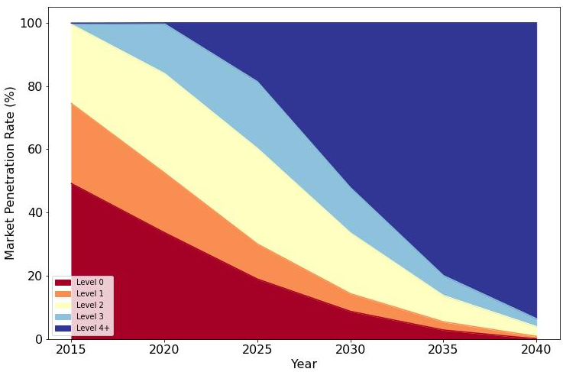
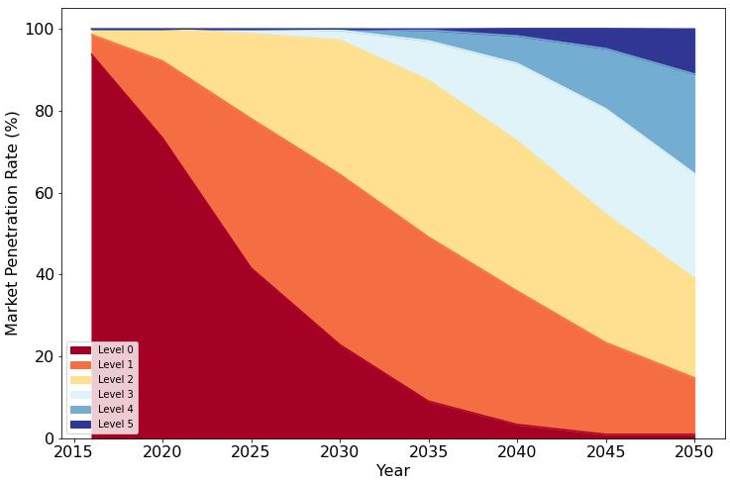
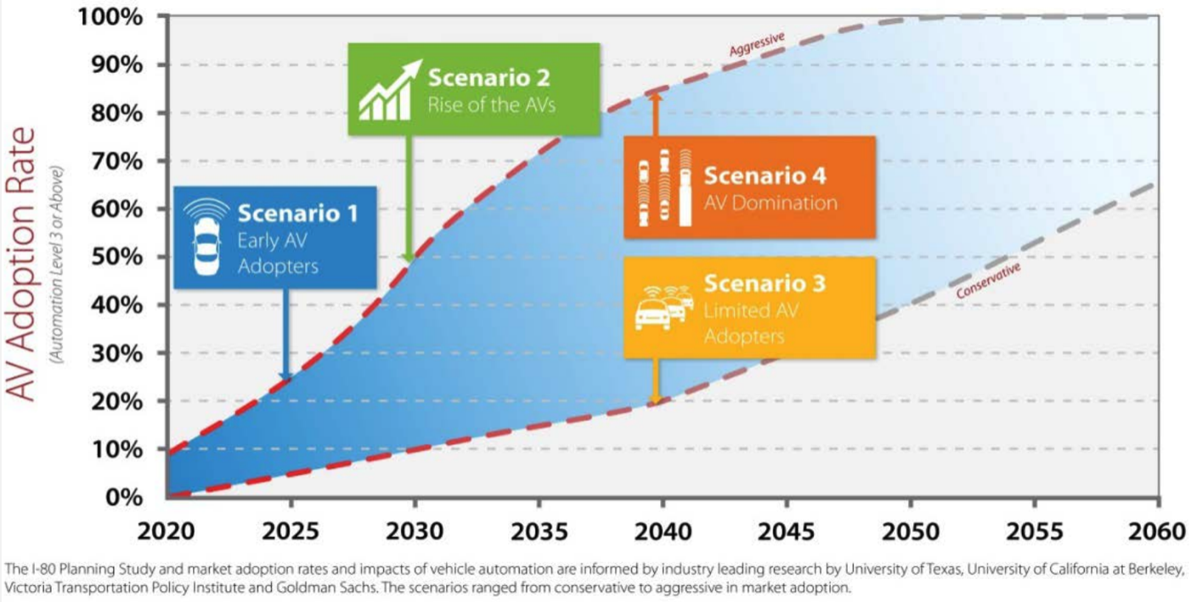
Market Penetration of Different Levels of Automation
The projection of the market of automated driving diversifies significantly resulted from differences in data sources, modeling approaches, and the factors considered. There are two types of prediction results: optimistic and pessimistic. The optimists (see Levison David’s book (2017)) believe that automated driving (Levels 1-4) would account for almost 80% of total vehicle fleet of which 20% would be Level 4+ in 2025, and by 2040, most of the vehicles on the market are anticipated highly autonomous. Alternatively, the pessimists (see L.E.K Consulting Company’s report, 2022) argue that, by 2025, Levels 1 and 2 would be the majority of vehicle automation yet higher automation will not be commercially available before 2030. Even though Levels 3 and 4 start to be commercialized beyond 2030, they will only be applied to premium luxury vehicles at the beginning. They also hold the point that Levels 3 and 4 would not hit 20% of the market until 2040 and 50% by 2050. In industry, there is a consistency that full automation (Level 5) cannot be realized until 2040, because of the unpreparedness of regulations, infrastructure, and AI technologies advancement. Considering the real progress of automated driving over the past 7 years, the pessimists’ projections are more reasonable and close to the reality. Also, the prediction from L.E.K. presents consistency with that from Iowa DOT who provided both optimistic and pessimistic AV adoption rate estimates based on different scenarios.
2016
Data Source: The End of Traffic and the Future of Access: A Roadmap to the New Transport Landscape. Levison, David.
2022
Data Source: https://www.lek.com/insights/ei/framing-investment-opportunities-along-long-road-fully-autonomous-vehicles
Source: Iowa DOT I-80 Planning Study Report

Slide 42
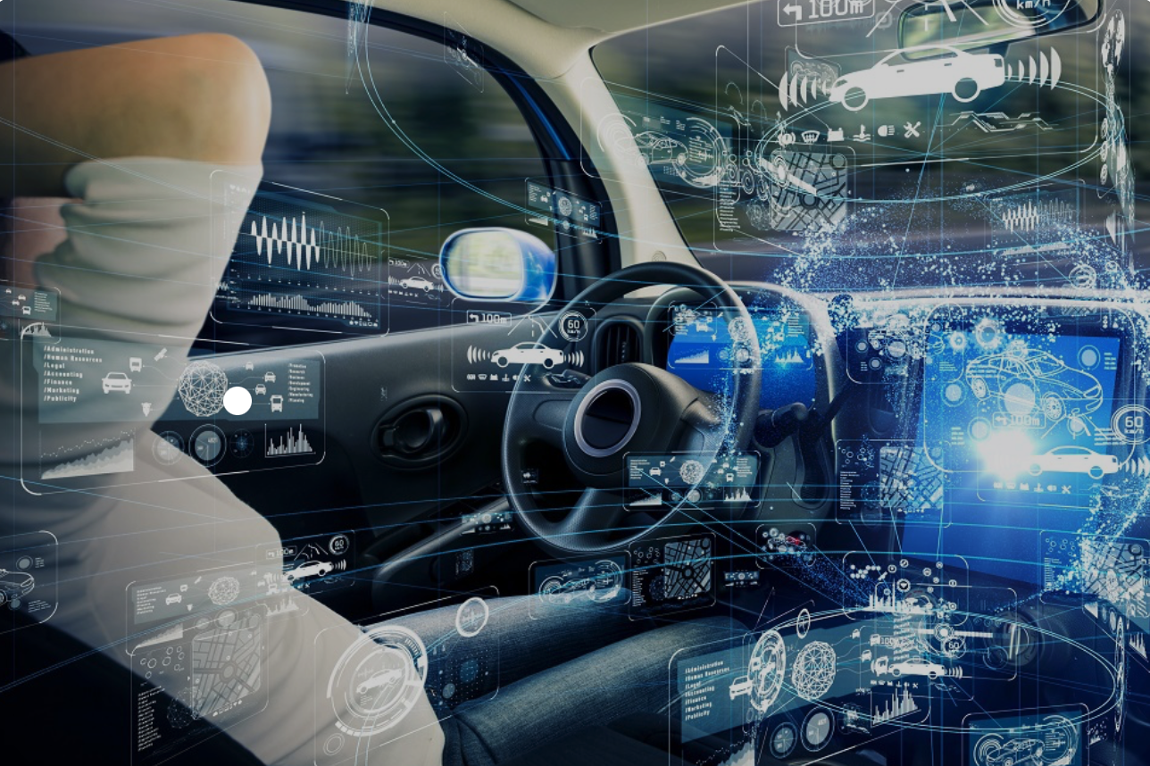

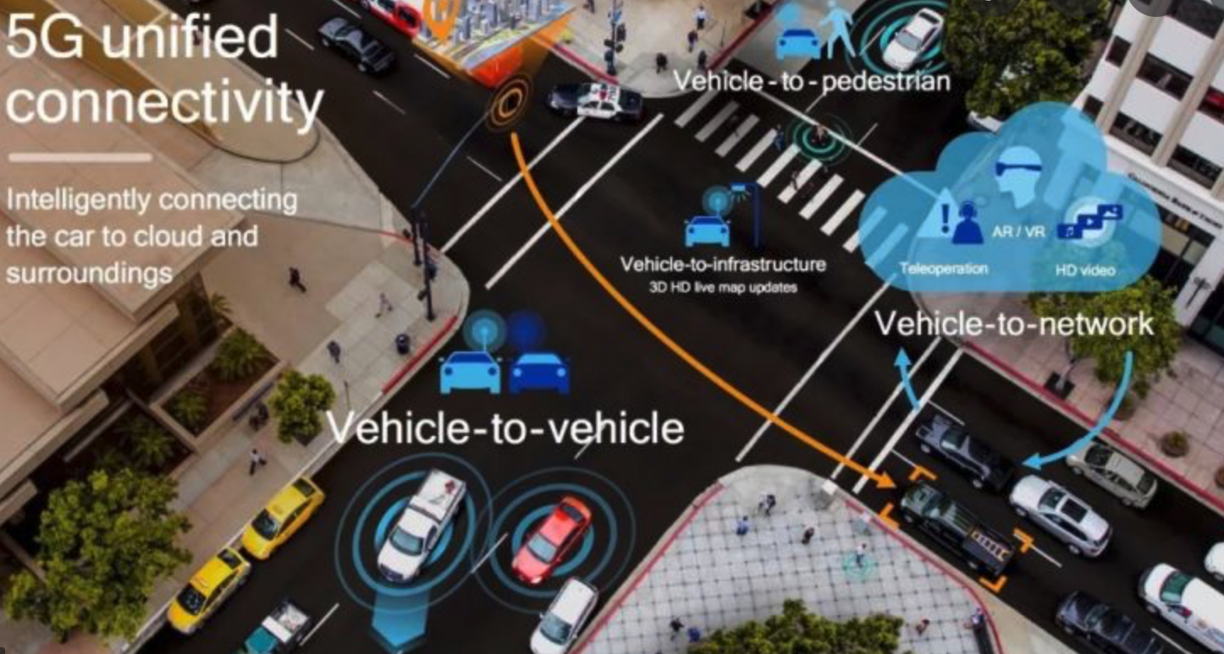
Market Penetration of Different Levels of Automation
Wave 1 Basic driver assistance
Wave 2
Acceleration of assisted driving
Wave 3
Introduction of autonomy
Wave 4
Adoption of fully autonomous
Automated driving will go through four waves of development from 2015 to 2050+ until widespread of full automation is achieved. Three important factors, namely technology, regulations and policy, and infrastructure, will be continually advanced.
2015
2020
2030
2040
2050+
Factors
Limited system-wide requirements; tech costs reduce with wider adoption | Individual component capability exists; cost and system-wide efficacy will need to be addressed | System-wide efficacy increases, and costs are reduced | Technological capabilities and costs appropriate; focus is on refinements vs. new wholesale developments
Limited regulatory requirements | Increasing regulations required as more autonomous features introduced | Federal and statewide regulations begin to be implemented | Federal and statewide regulations widespread
Limited infrastructure investment required | Limited infrastructure investment required | Increasing Infrastructure investment will help improve autonomous system performance | Infrastructure can improve performance and safety of higher autonomy levels; may be mandated
Technology
Regulations and Policy
Infrastructure
Level 0 sales wane as Levels 1 and 2 gain share
Level 0 sales continue decline as ADAS Level 1 and especially Level 2 gain share
Level 3 begins to gain traction, reaching 5%-10% of sales by end of 2030
Level 3 gains share of expense of Levels 1 and 2, representing over one-third of all vehicles sold
Level 4 technology and cost improve and reach 20%-25% of sales
Level 5 begins to make small on roads
Levels 4 and 5 sales accelerate, accounting for over 70% of new sales by the end of period
Levels 0-3 sales wane

Slide 43
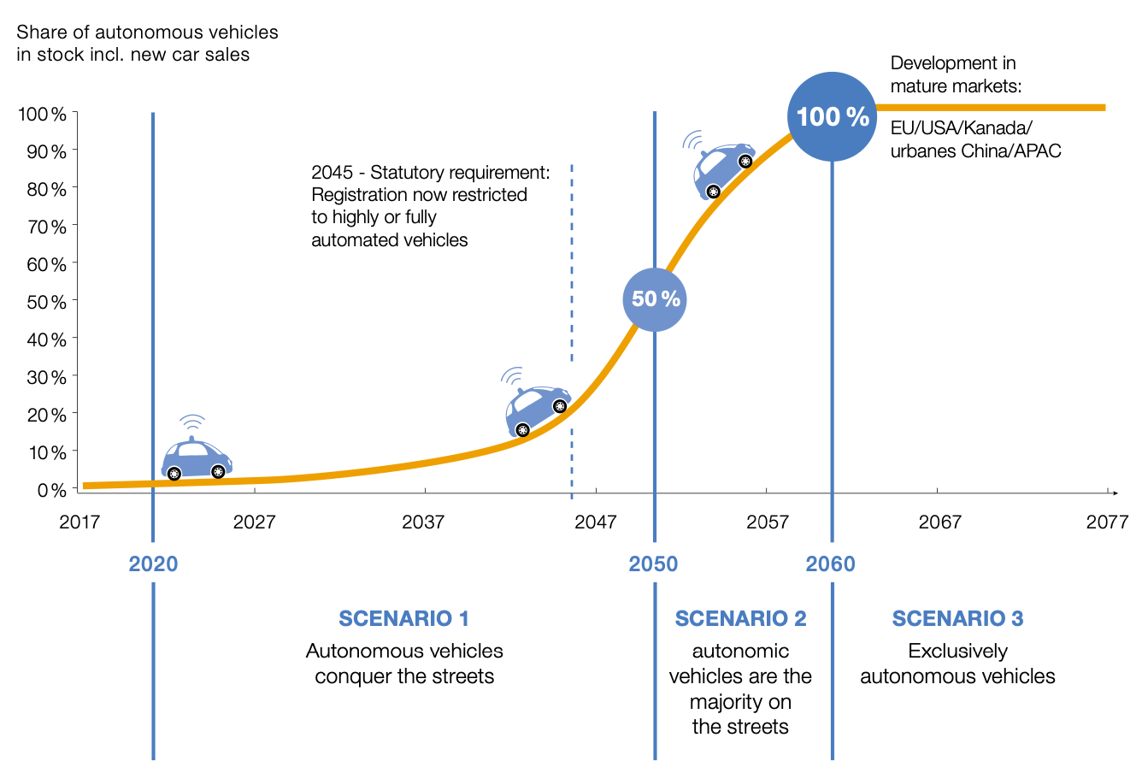
Long-term Projection of AV Market Share
The trend of a new technology deployment typically follows the “S” curve as demonstrated in the figure below. There is no exception for automated driving. Based on the prediction from the NTT Data company, highly or fully autonomous vehicles will be in the phase of “conquering” streets between 2020 and 2050 when low automation (Levels 1, 2 and 3) will be first deployed followed by Levels 4 and 5. Before 2045, the market share of Level 4+ will not be higher than 20%; beyond 2045, it is expected to increase sharply. In the second phase (2050-2060), the share of Level 4+ vehicles will continue increasing rapidly and occupy the majority of the market. Around 2060, the technology that makes completely autonomous vehicles possible will have been completely developed in Phase 2, and fully autonomous vehicles are anticipated to account for 100% market share in most of the developed areas in the world like the United States, China, European Union, Canada, and other Asia-Pacific areas.
Source: NTT Data, https://us.nttdata.com/en/-/media/assets/white-paper/mfg-autonomous-cars-white-paper.pdf

Slide 44
Automated Vehicle Technologies and Applications
This section will introduce the technologies associated with automated vehicles and their applications in the mobility field, covering the following areas:
Automated driving technologies
Automated driving Applications
Applications associated with energy efficiency and emissions

Slide 45
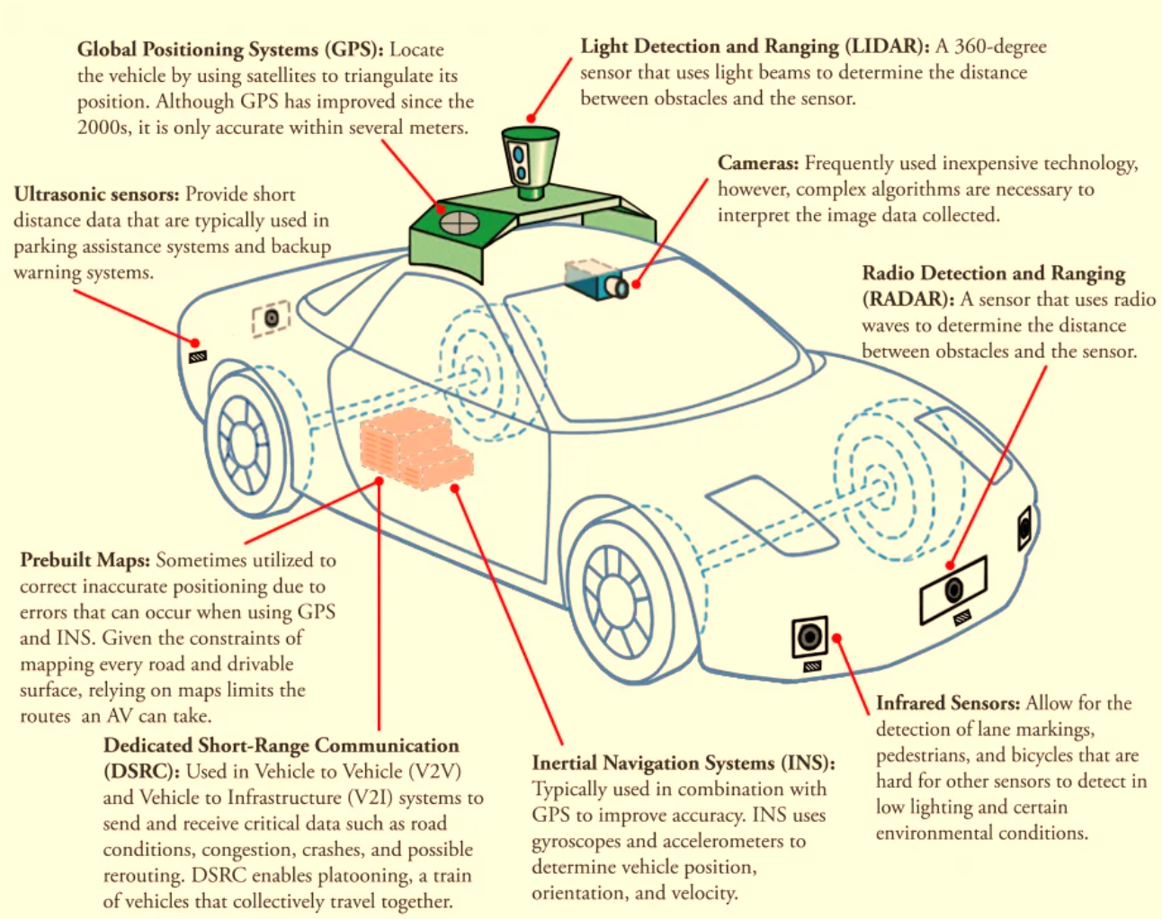
Automated Driving Technologies
Automated vehicles use combinations of technologies and sensors to sense the environment such as infrastructure, nearby vehicles, pedestrians, and other surrounding objects. The core technologies include Global Positioning Systems (GPS), ultrasonic sensors, prebuilt maps, wireless communication (e.g. dedicated short-range communication (DSRC) and 5G), inertial navigation systems (INS), infrared sensors, radio detection and ranging (RADAR), cameras, and light detection and ranging (LIDAR). These technologies are generally applicable to both light-duty and heavy-duty vehicles.

Slide 46
Automated Driving Hardware Technologies
The core sensing, communications, and software technologies are generally applicable to both light-duty and heavy trucking sectors (National Academies of Sciences, Engineering, and Medicine, 2017). Most of the automated vehicle hardware technologies have low cost of at most hundreds of dollars. DSRC is currently the major communication technology before wide commercialization of 5G. Compared to hardware, software technologies, such as algorithms, AI, high performance computing and data processing, will bring larger challenges to automated driving, which may result in much higher expenses.
Technology | Components | Reference | Target Year | Cost | Commercial Availability | Example Technology Makers
Sensors | LIDAR | Davis (2022) | 2022 | $90-$8,000 | Yes | Velodyne LiDAR, LeddarTech, Quanenergy, Delphi, Strobe, Waymo
 | Radar | Davis (2022) | 2022 | $50-$150 | Yes | Bosch, Continental, Autoliv, Delphi
 | Cameras | Davis (2022) | 2022 | $125-$200 | Yes | Continental, Mobileye, Delphi
 | Ultrasonic sensor | Davis (2022) | 2022 | $15-$20 | Yes | Delphi, Mobileye, Bosch
 | GPS | Davis (2022) | 2022 | $80-$6,000 | Yes | Linx Technologies, GeoTab
 | Inertial sensor | Youssef and EI-Sheimy (2019) | 2019 | <$10 | Yes | Northrop Grumman Corp., MEMSIC Inc., Tersus GNSS, SBG Systems
 | Infrared sensor | Thakur (2017) | 2020 | <$100 | Yes | Bosch, Continental, Delphi
Communications | DSRC | USDOT (2013) | 2022 | $75 | Yes | NXP, Qualcomm
 | 5G | Unspecified |  | Unspecified | No | Huawei

Slide 47
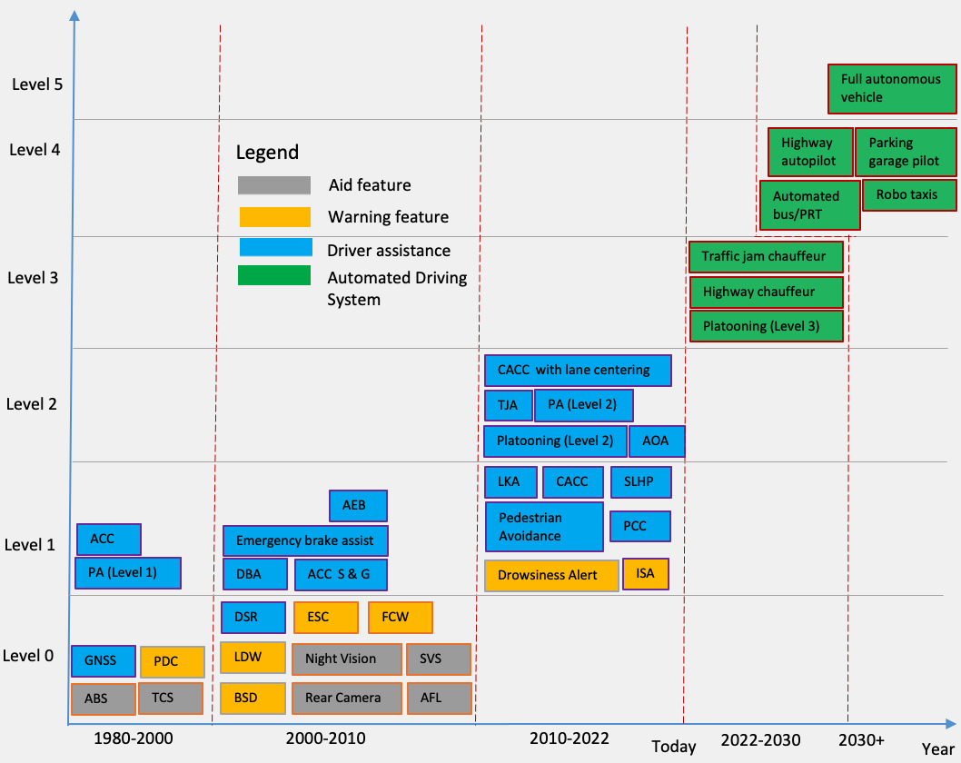
Automated Driving Applications Roadmap
Notation:
ABS: Anti-lock Brakes System
TCS: Traction Control System
ESC: Electronic Stability Control
PDC: Parking Distance Control
FCW: Front Collision Warning
PA (Level 1/2): Parking Assist (Level 1/2)
ACC: Adaptive Cruise Control
BSD: Blind Spot Detection
LDW: Lane Departure Warning
AFL: Adaptive Front Lights
SVS: Surround View Systems
TJA: Traffic Jam Assist
DSR: Dynamic Steering Response
DBA: Dynamic Brake Assist
ACC S & G: Adaptive Cruise Control with Stop and Go
AEB: Automatic Emergency Brake
ISA: Intelligent Speed Adaption
CACC: Cooperative Adaptive Cruise Control
SLHP: Single Lane Highway Pilot
LKA: Lane Keep Assist
PCC: Predictive Cruise Control
AOA: Automated Obstacle Avoidance
PRT: Personal Rapid Transit
GNSS: Global Navigation Satellite System

Slide 48
Costs for Examples of Automated Driving Applications
Applications | Functionalities | Technologies Used | Example Players | Extra Cost | Sources
Lane Departure Warning (LDW) | Provide a warning when vehicles drive outside of the lane | Cameras, software | Mobileye, Wabco, Meritor | $850 with $150 installation | National Academies of Sciences, Engineering, and Medicine (2017)
Blind Spot Detection (BSD) | Identify drivers’ blind spot and give a warning | Cameras, Radar, software | Mobileye, Volvo, Wabco | $250-$850 | National Academies of Sciences, Engineering, and Medicine (2017)
Adaptive Cruise Control (ACC) | Dynamically control longitudinal movement and maintain consistent following distance | Radar, software | Mobileye, Wabco, Volvo, Bendix | $500-$2500 | Adaptive Cruise Control: A Safer Way to Drive? (2022)
Predictive Cruise Control (PCC) | Optimize vehicle speed over various types of terrain | GPS, topographical mapping data, software | Kenworth, DAF | $953 for 2018, $766 for 2027 | EPA and NHTSA (2016)
Truck platooning | Enable vehicles to travel close together to reduce aerodynamic drag | Radar, software, DSRC | Volvo, Peloton, Daimler | Around $1,000 for 2022 | Larson (2020)
Front Collision Warning (FCW) | Detect distances and relative speed between two adjacent vehicles and give a warning when they are too close | Radar, software | Delphi, Bosch, DENSO | <$300 for 2022 | Retail webs like Amazon and eBay
Cooperative Adaptive Cruise Control (CACC) | Extension of ACC using V2X communication, realize longitudinal automated driving | LiDAR, Radar, software | Delphi, NeoGLS, Dynniq, Swarco | $300-$10,800 with a median cost of $4,500 | USDOT (2018)
Highway chauffeur | Conditional automated driving (Level 3) up to 90 km/h on motorways | LiDAR, radar, cameras, ultrasonic sensor | Tesla, Waymo, Cruise | Around $4,500 (2016) with decline at an annual rate of 9% | Studer et al. (2018) Stephens (2016)
Full automation | Provide full self-driving features and enable vehicles to drive anywhere anytime without human interventions | LiDAR, radar, cameras, infrared/ultrasonic sensors, GPS, DSRC/5G | Tesla, Waymo, Cruise | $15,000 in 2022 for Tesla, around $10,000 for others | Elon Musk (2022) Stephens (2016)

Slide 49
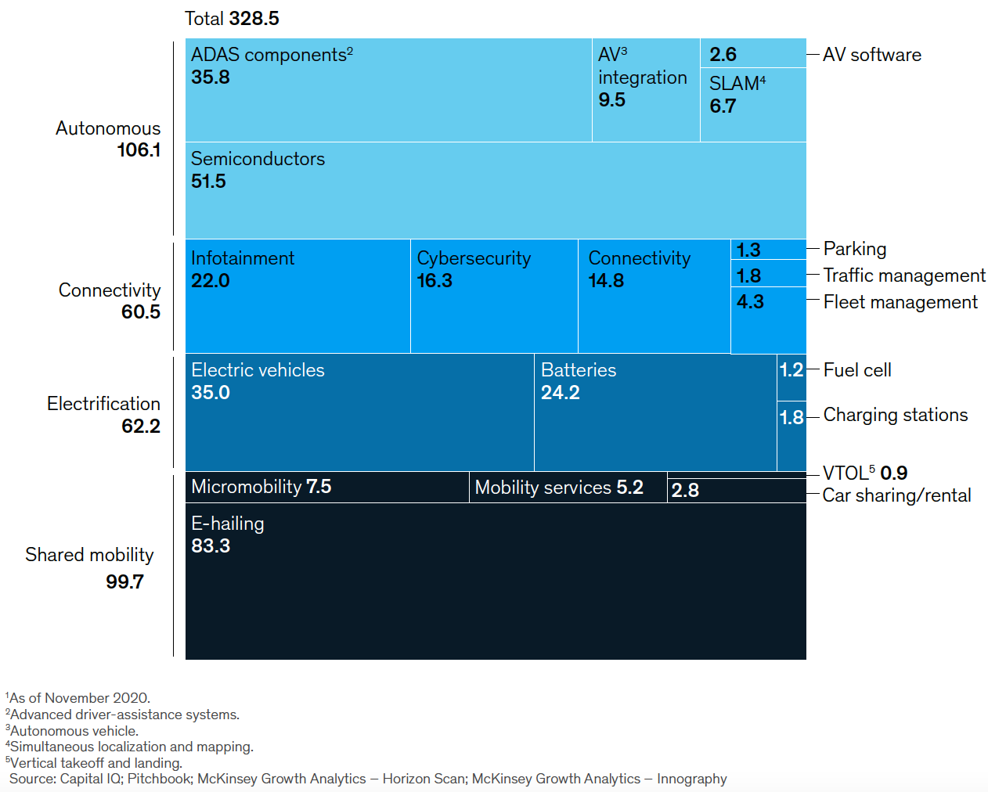
Mobility Technologies: Automated, Connected, Shared, Electric
Other than automation and connectivity, sharing and electrification also account for a significant share of the mobility market. According to McKinsey, from 2010 to 2020, almost half of the funds flowed into the sector of vehicle electrification and shared mobility, pretty close to automation and connectivity. More findings have agreed that either of these technologies alone cannot successfully achieve the expected mobility benefits. Therefore, integrated applications of these technologies have been increasingly attractive in both academia and industry. Most of the applications associated with automated driving, such as vehicle platooning and shared automated vehicles, involve the other three technologies.
Source: McKinsey report—Mobility’s future: An investment reality check

Slide 50
Technology of Connectivity
Automation alone cannot achieve expected mobility benefit. Without connectivity, automated vehicles are unable to communicate with each other and the environment, which fails to collect critical data for operation planning and optimization. Connected vehicles are thus usually bundled with automation to deliver mobility applications. To facilitate the debate of connectivity technologies in a manner similar to automated vehicles, Privacy4Cars proposed a standardized definition of the Levels of Driving Connectivity parallel to the Society of Automotive Engineers (SAE) AV framework (Levels 0-5). Level 4 and above constitute the majority of new sales today. Level 5 highly depends on the quality and reliability of communication and has not been widely commercialized.
Levels of Connectivity | Level Summary | Descriptions | Example Functions
Level 0 | No connectivity | Unable to connect to internet or any other devices, no Bluetooth | None
Level 1 | Local connectivity only | Can connect to local devices like Bluetooth and USB | Hands-free calling, audio streaming
Level 2 | Indirect connectivity via connected devices | Can connect to other devices via Bluetooth and USB and offer OEM-designed connected services | Live traffic updates, weather updates
Level 3 | Direct connectivity | Vehicle has its own native connectivity (i.e. telematic connection) to offer in-vehicle services only | Anti-theft, e-Call
Level 4 | Direct connectivity | Vehicle has its own native connectivity (i.e. telematic connection) to offer OEM online services inside and outside of vehicles | In-vehicle Wi-Fi, SiriusXM, Google Maps, vehicle health updates
Level 5 | Direct connectivity | Interact with infrastructure (V2I) and other connected vehicles (V2V) in real time | Automated tolling and parking, advanced traffic management, platooning
Source: Privacy4Car (https://privacy4cars.com/data-in-cars/p4cs-five-levels-of-vehicle-connectivity/)

Slide 51
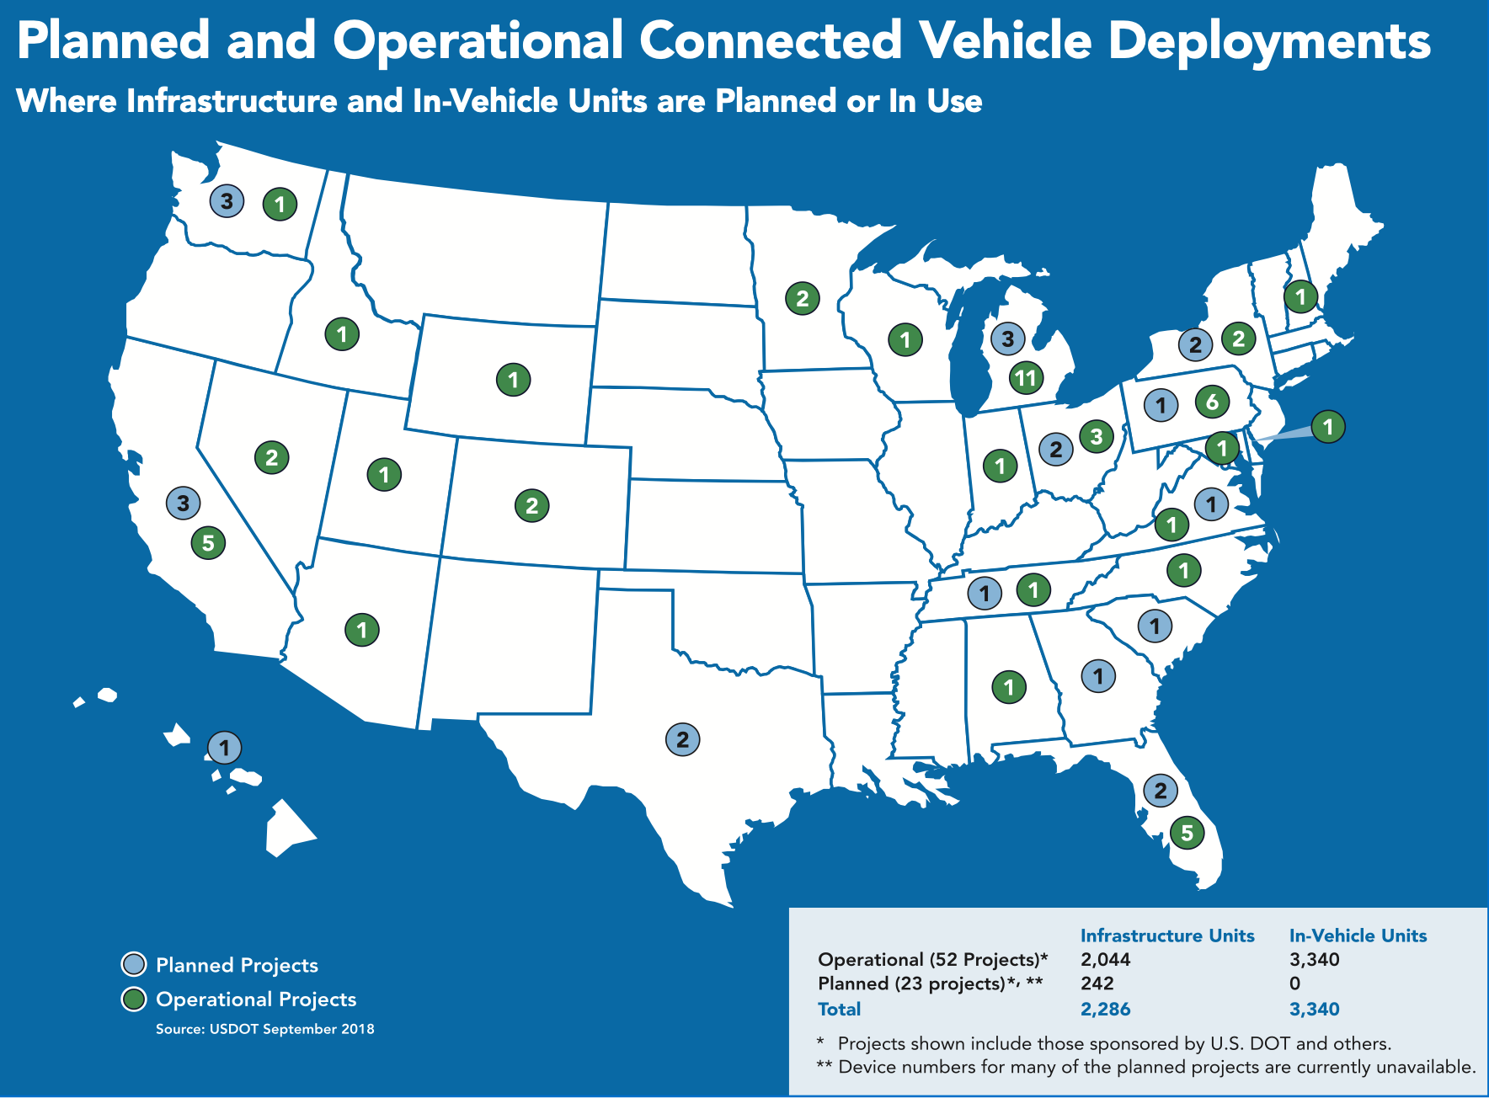
Deployment of Level 5 Connectivity in the United States
The United States initiated the study of the Level 5 connectivity program in 1999 when Federal Communications Commission (FCC) started to use DSRC in ITS. Over the past 20 years, there are 52 connected vehicle projects deployed across the country, with 23 planned. For those deployed, there have been 2044 connected units put in use for infrastructure and 3340 in-vehicle. For those planned, all of them will be deployed for infrastructure. Among states, Michigan has deployed the most projects, followed by Pennsylvania, California, and Florida.
Source: NHTSA

Slide 52
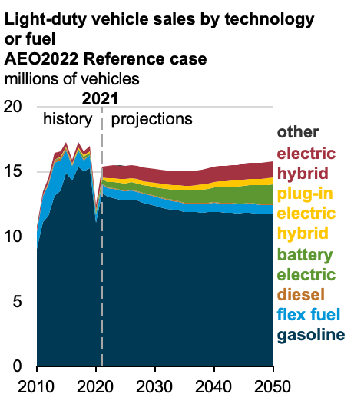
Vehicle Electrification
The ownership of electric vehicles (EVs) has a sharp growth over the past 5 years especially in China and Europe. The momentum of the growth will become much stronger in the next 20 years in all regions of the world. China, Europe, and the United States will become the three largest EV market. EV include battery electric, plug-in hybrid, and fuel cell electric vehicles. With the advancement of H₂ technology, hydrogen fuel cell EVs are increasingly competitive to battery EVs. Given its advantages in terms of higher driving range and shorter charging time, fuel cell EVs are preferred over battery EVs (BEVs) especially in the truck sector.
Source: BNEF. Note: EVs include battery-electric and plug-in hybrid electric vehicles. Europe includes the EU, the UK and EFTA countries.
According to the recent prediction from U.S. EIA, the new sales of conventional ICE vehicles in the United States will continue dropping over the next decades. Alternative fuel vehicles (AFVs), such as BEV, plug-in (hybrid), and hydrogen fuel cell, will gradually occupy the market. However, ICE vehicles will still be the majority of the fleet at least until 2050 maybe longer. Therefore, different propulsion technologies will coexist for a long time. Vehicles with different fuel types will be mixed traveling in the transportation system. How does automated driving technologies change the operation and energy efficiency of different types of vehicles? How will the mixed traffic of automated vehicles with different fuel types disrupt mobility patterns and system energy demand and emissions? The answers to these questions are unknown and remain to be deep dived.
Source: U.S. EIA Annual Energy Outlook 2022

Slide 53
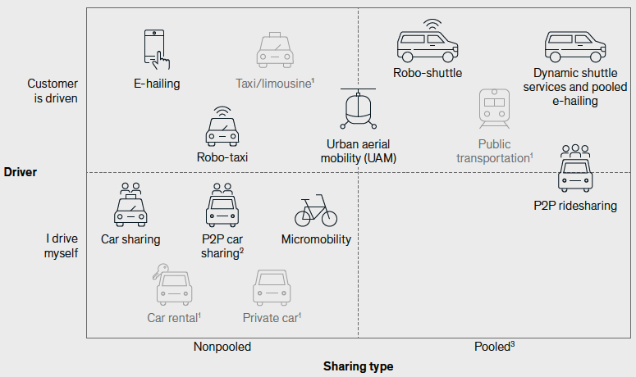
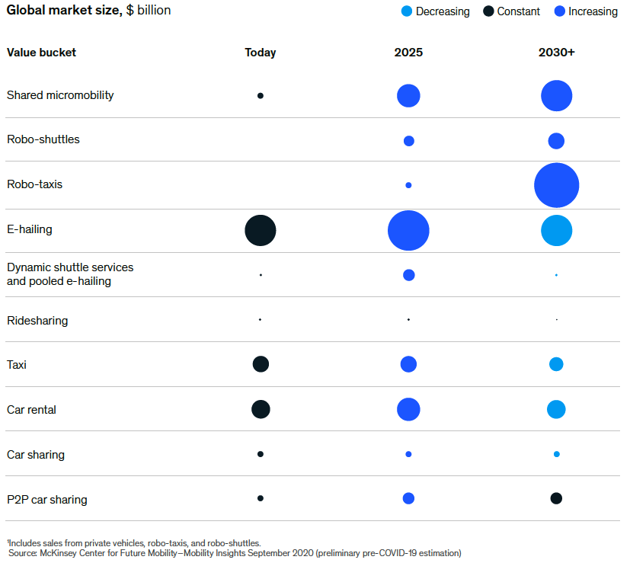
Shared Mobility Development
shared mobility is a transportation system where travelers share a vehicle either simultaneously as a group (e.g. ride-sharing) or over time (e.g. carsharing or bike sharing) as personal rental, and in the process share the cost of the journey, thus creating a hybrid between private vehicle use and mass or public transport. It encompasses a variety of transportation modes including carsharing, micro-mobility, e-hailing, bicycle-sharing, dynamic shuttle, carpools, and Robotaxis, in either human-driven or automated mode. The proliferation of shared mobility services happened a decade ago when transportation network companies (TNC) like Uber, Lyft and DiDi were founded. Since 2010, the global market size of shared mobility services have been continually grow especially for E-hailing. With the integration with automated driving, the market of shared autonomous vehicles (SAV) is anticipated to have a dramatic growth over the next 10 years especially for Robo-taxis, as reported by McKinsey. However, it is still highly uncertain how SAVs will disrupt our known mobility world and impact transport energy demand and emissions.

Slide 54
Applications Associated with Energy Efficiency and Emissions
Mobility Technologies
Technology-driven Applications
Factors
Dynamic Route Planning
Eco-driving
Dynamic Speed Harmonization
Advanced Platooning
Intelligent Parking
Signal Optimization
Incident Management
Shared Automated Vehicle (ride-hailing, ride-sharing, Robotaxis, dynamic shuttle services, urban air mobility, ......)
Mobility-as-a-Service (MaaS)
Alternative Fuel Vehicle Charging Decision
Battery Management Optimization
Vehicle-to-Grid Optimization
……
Adaptive Cruise Control (ACC)
Cooperative Adaptive Cruise Control (CACC)
Predictive Cruise Control (PCC)
Platooning
Global Navigation Satellite System (GNSS)
Conditional Automated Driving
High/Full Autonomous Driving
Travel Behavior
VMT
Vehicle Connectivity
Mobility Sharing
Vehicle Electrification
FE
Fuel choice

Slide 55
Automated Driving Implications on Transport Energy and Emissions
This section will discuss the combined effects of new mobility technologies on energy and emissions; namely, automation, connectivity, sharing, and electrification, covering the following areas:
Why study AV implications on energy and emissions?
Positives and negatives of automated driving
The state-of-the-art about quantifying energy and environmental implications of AVs
Research gaps for this subject matter

Slide 56
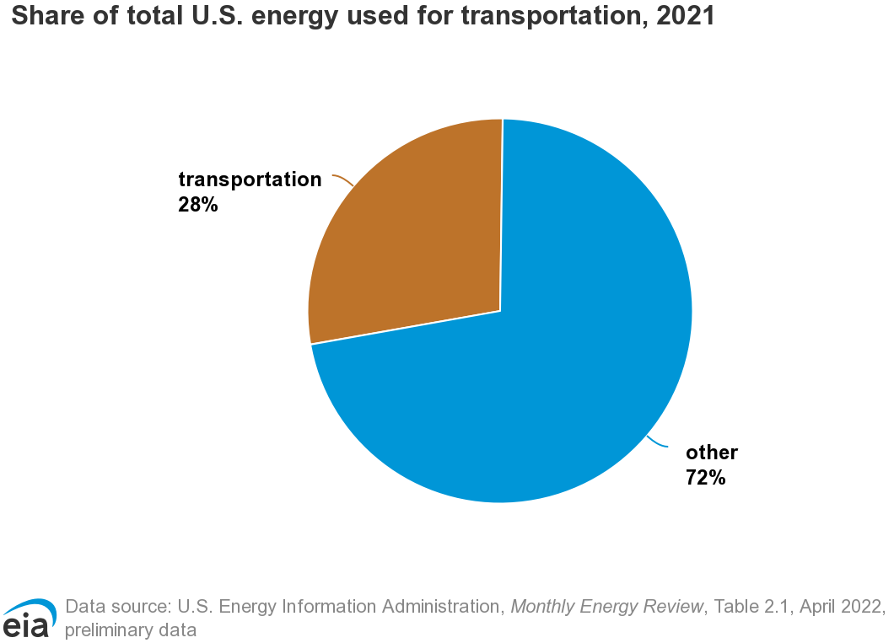
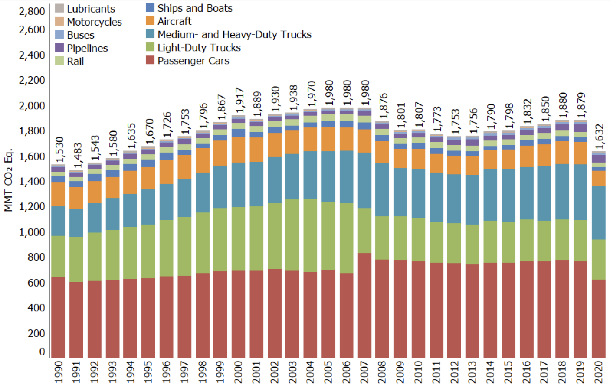
Why Study AV Implications on Energy and Emissions?
Transportation contributes 28% of the total energy use in the United States in 2021. Among that, road transport accounts for the most. EIA reported that, from 1990 to 2020, more than 80% of the energy consumption in transportation came from on-road vehicles. Automated driving is anticipated to disrupt the off-the-shelf transportation system especially on-road mobility. Therefore, it is critical to have a clear picture of how the emerging technologies associated with automated driving will change travel patterns and thus energy consumption and emissions. The research findings will provide valuable insights into transportation decarbonization in future mobility and help Aramco to make sustainable decision in oil business.
Source: Figure 2-14 Inventory of U.S. Greenhouse Gas Emissions and Sinks: 1990-2020

Slide 57
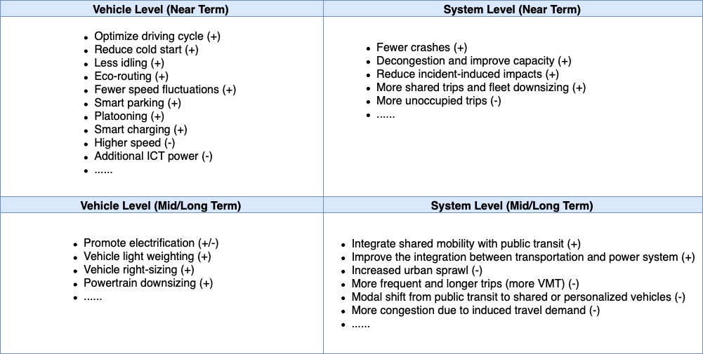
Positives and Negatives of Automated Driving—AV-Facilitated Transformations
AV technologies have delivered or will initiate many applications that may change travel behavior and mobility patterns and further impact vehicle miles traveled (VMTs) and fuel efficiency. Put another way, energy and environmental implications of automated driving do not stem from the technologies directly, but from AV-facilitated transformations of mobility system. The table below specifically describes what kind of transformations potentially occur resulted from AV-related applications. Basically, the transformations may happen at either vehicle or system level and may have near-term or far-reaching impacts. Each of the dimensions may result in both positive and negative outcomes. For example, at the vehicle level, automated driving probably improves energy efficiency by optimizing driving cycle, reducing cold start, less idling, energy-efficient routing, decreasing speed fluctuations, intelligent parking, platooning, and smart charging, but may also render more energy use given higher operation speed and extra power required by AV-associated technologies and equipment. At the system level, automated driving is likely to improve road capacity, reduce incidents impact, decongest, better integrate shared mobility with public transit, encourage more shared trips, and downsize fleet, yet may also result in more unoccupied trips, extra travel demand, and urban sprawl. In a nutshell, AV-related technologies are a double-edged sword, which requests seamless cooperation among government, industry, and academia to regulate and rationalize deployment activities.

Slide 58
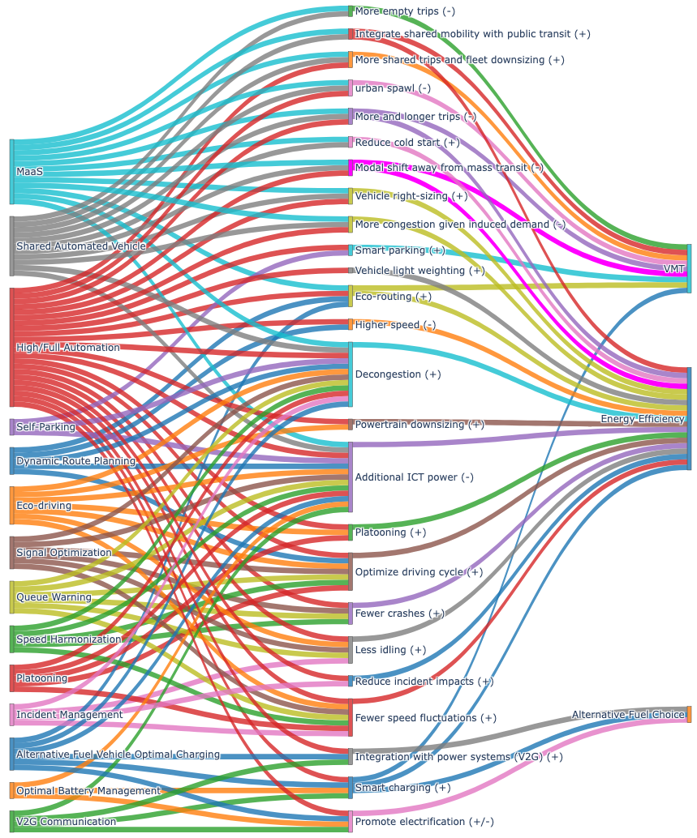
Positives and Negatives of Automated Driving—AV-Facilitated Applications VS. Transformations
To better understand which applications trigger what transformations, a Sankey diagram has been provided below to visualize the relationship between AV applications and its facilitated mobility transformations. In general, many of the applications may have both positive and negative impacts on energy efficiency, depending on how those applications are deployed.
AV-enabled Applications
AV-facilitated transformations
User-end impacts

Slide 59
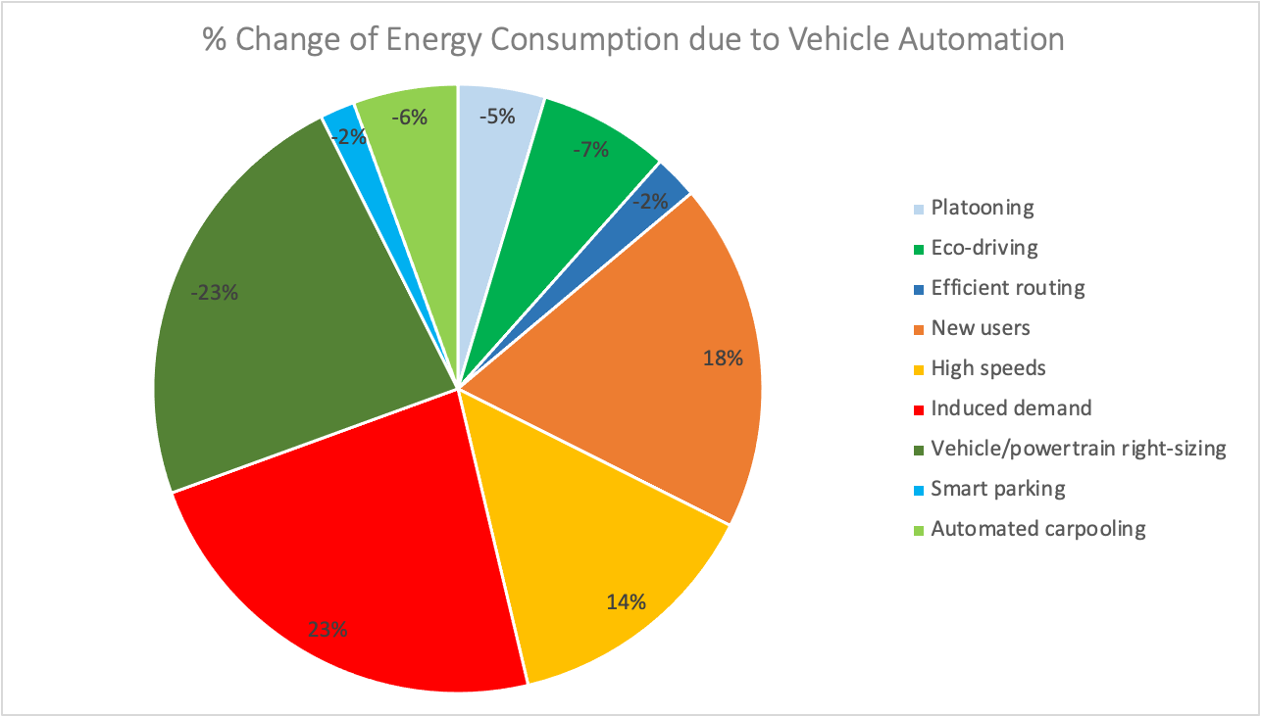
The State-of-the-art About Quantifying AV Implications on Energy and Emissions
The National Renewable Energy Laboratory (NREL) is one of the earliest research institutes that quantifies automated driving implications on energy consumption. Brown et al. initiated a study in 2014 that evaluated the impact of each of the typical AV applications on energy efficiency. The research found that vehicle right sizing or powertrain downsizing would achieve the maximum level of energy reduction, yet it could not be realized until high penetration of full/high automation was in the market, which is still decades away. Other applications, including platooning, eco-driving, efficient routing, smart parking, and automated carpooling, are able to reduce energy consumption from 2% to 7%. Nonetheless, AV technologies may also enable negative transformations such as higher speed, induced more and longer travels, and more trips from new users like underserved people. These are likely to increase energy demand and GHG emissions. The amounts of the percentage change in the study were mainly collected from simulation studies or other reviews of literature. One of the most significant disadvantages of the study is that it provides a single value of energy change rather than a range that is able to address the uncertainties of those implications. In practice, the energy changes of the same AV applications are very likely to be different between studies depending on scenarios. Hence, a robust evaluation should be capable of explaining such variability to address uncertainties.
Brown et al. (2014), NREL

Slide 60
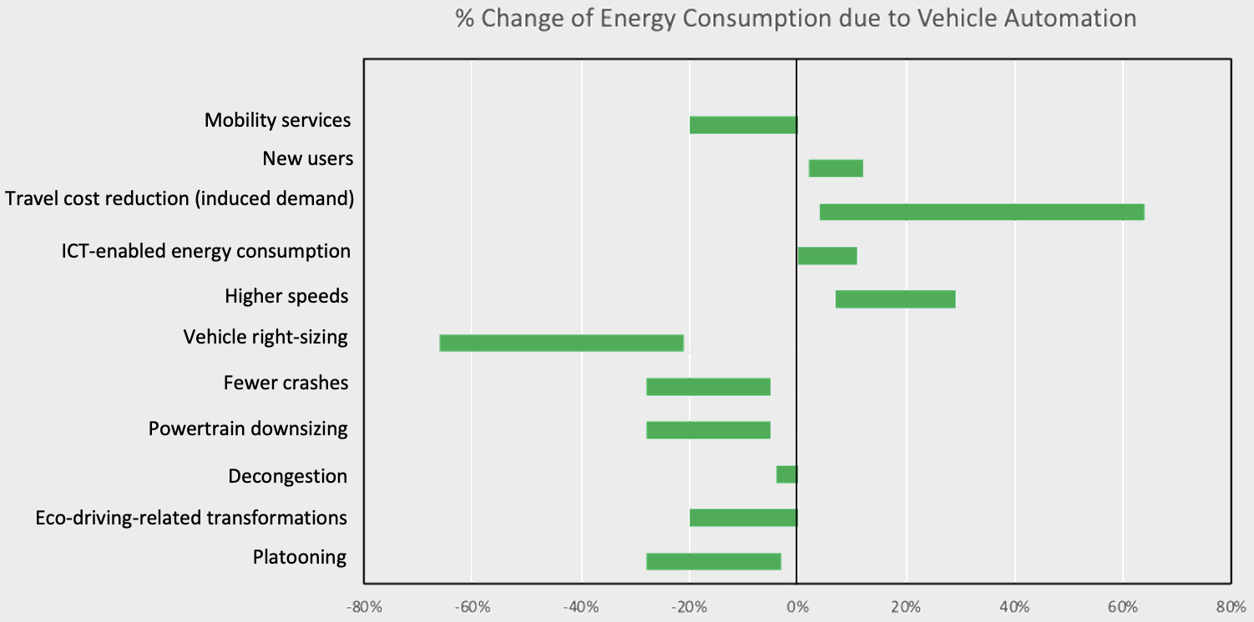
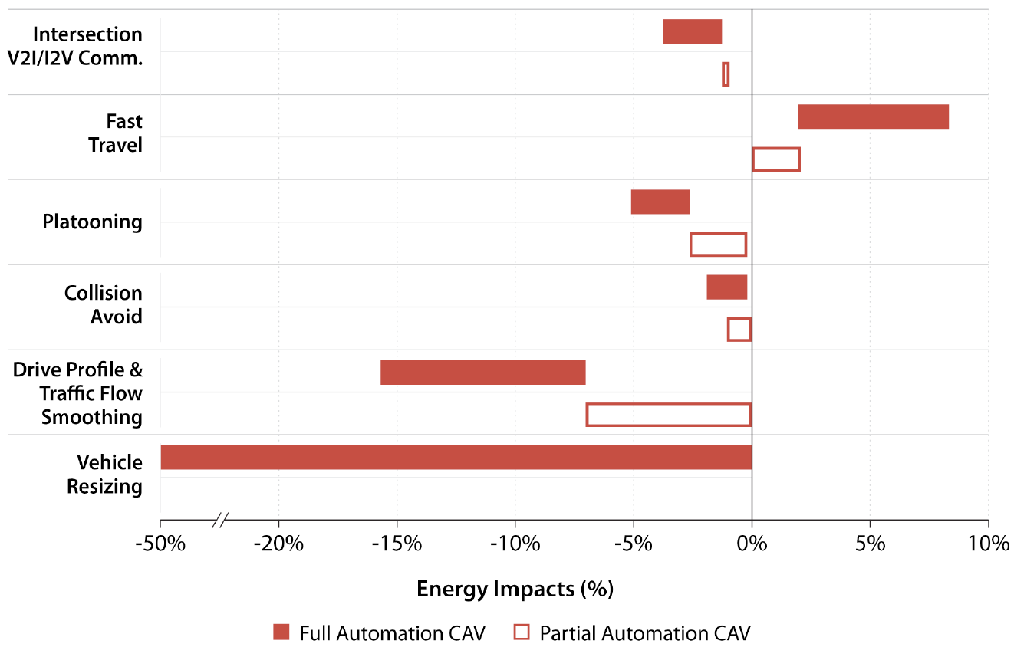
The State-of-the-art About Quantifying AV Implications on Energy and Emissions
NREL and University of Washington conducted the follow-up studies of the Brown’s by delivering the range values of implications for each of the typical AV applications. NREL proposed that vehicle right-sizing resulted in the most energy reduction of 21%-65%, yet travel cost reduction generated significantly more demand which produced 5%-65% more energy consumption. Stephens et al. from NREL evaluated the impacts of 6 AV-facilitated transformations on energy consumption. They delivered different range values for the same transformations such as faster travel (higher speeds), platooning, fewer crashes (collision avoidance), eco-riving, and vehicle right-sizing. Nonetheless, they both indicated the significant implications of induced demand, higher speeds, and vehicle sizing.
University of Washington, Wadud et al. (2016)
Stephens et al. (2016), NREL

Slide 61


The State-of-the-art About Quantifying AV Implications on Energy and Emissions
Researchers from Energy Information Administration (EIA) and NREL (Chen et al. (2019)) aggregated the implication of each AV transformation into partial (Levels 1-3) and full (Levels 4-5) automation. Both turned out that there were considerable uncertainties surrounding the energy consumption impact, particularly pronounced for high and full automation. Such high uncertainties motivate government, industry and academia to work collaboratively to advance technologies and regulate AV activities, so that avoiding mobility and energy bane resulted from AVs. Automated driving will move forward progressively with the collaborative efforts, which proposes the need to continue investigating the energy and environmental implications of AV technologies.
EIA (2017)
Explanation of Scenarios:
No AVs: all conventional human-driven vehicles
Base: take the mid-point of the range values from Wadud’s study
Optimistic: least energy consumption
Pessimistic: most energy consumption
Automated highway/urban: impact of AV only realized on highway or urban respectively
AV change travel after 2030: range values are the same as base scenario except that travel demand impact occurs only after 2030
Stuck in partial automation: all AVs are partial automation.
Chen et al. (2019), NREL

Slide 62

The State-of-the-art About Quantifying AV Implications on Energy and Emissions
Chinese scholars at Tsinghua University also quantified AV implications on energy and GHG emissions. They combined the quantitative implications summarized from literature with the results from the simulation scenarios they designed, and generated the percentage change of energy consumption induced by the AV-enabled transformations, including eco-driving, decongestion, vehicle weight change, faster speed, crash avoidance, information and communication technology (ICT) energy consumption. These numbers were then aggregated into full and partial automation respectively. Both ICEVs and BEVs were evaluated in this study. The range of implications were finally provided for each level of automation, as demonstrated in the red box of the figure below. According to the results, the uncertainties are not as large as those from NREL and EIA studies, and the impact on BEVs is not significantly different compared to ICEVs.
Liu et al. (2019), Tsinghua University

Slide 63
The State-of-the-art About Quantifying AV Implications on Energy and Emissions
Dozens of literature with regard to energy implications of AVs have been reviewed, six of which are most representative and listed in the table. Most of the studies investigated both partial (Levels 1-3) and full automation (Levels 4-5), with an emphasis on ICEVs except for Liu et al. (2019) which involves BEVs as well. For market penetration rate (MPR), it is either assumed to be 100% or obtained from the estimates of literature. Energy rebound effect were considered by most of them, yet the estimates were based on either oversimplified assumptions or rough approximation without deep diving the behavioral mechanism behind the effects. None of the studies has involved life cycle emissions and the traffic flow with mixed vehicle and fuel technologies, such as the mix of CAVs vs. non-CAVs, partial and full AVs, ICEVs, BEVs, PHEVs, and Hydrogen FCVs. Meanwhile, only a few studies have included ICT-enabled power consumption as part of total AV energy consumption.
Study | Level of Automation | Market Penetration Rate (MPR) | Fuel Type | Traffic Flow with Mixed Technologies | Rebound effect | ICT-induced Power | Life Cycle Emissions
Brown et al. (2014) | Full automation | Assume 100% | ICEV | ✕ | ✓ | ✕ | ✕
Wadud et al. (2016) | Partial automation Full automation | Assume 100% | ICEV | ✕ | ✓ | ✕ | ✕
Stephens (2016) | Partial automation Full automation | Estimates from IIHS, Highway Loss Data Institute (HLDI) | ICEV | ✕ | ✓ | ✕ | ✕
EIA (2017) | Partial automation Full automation | Estimates from IIHS, Highway Loss Data Institute (HLDI) | ICEV | ✕ | ✓ | ✕ | ✕
Chen et al. (2019) | Partial automation Full automation | Estimates from McKinsey | ICEV | ✕ | ✓ | ✕ | ✕
Liu et al. (2019) | Partial automation Full automation | Estimates from Boston Consulting Group (BCG) | ICEVBEV | ✕ | ✕ | ✓ | ✕

Slide 64

Research Gaps and Recommendations
A comprehensive review of the literature with regard to energy and emissions implications of automated driving has provided a wealth of valuable insights into future endeavors, which are described as follow:
Market penetration rate (MPR) determines the proportion of AVs in the transportation system and is an very important factor that impact vehicle operation, travel behavior, and thus energy efficiency. Most of the existing studies, however, either simply assumed a 100% market penetration rate (MPR) of AVs or used MPR estimates from consultants such as McKinsey and research institutes like Insurance Institute for Highway Safety (IIHS). Many of those estimates were generated years ago when AVs development was extremely crazy, which delivered optimistic predictions. Yet, AV development is not moving forward smoothly as expected. This brings investors back to rationality most recently and cools down the entire AV industry. The MPR prediction should involve the recent transformation and change over time. Also, other than the productivity of industry, consumers adoption behavior is another important factor that disturbs the market share of AVs. Both should be collectively modeled in future studies.
The majority of the studies deliver the AV-facilitated energy change resulted from oversimplified assumptions that 100% of the fleet are gasoline or electric vehicles. However, multiple fuel technologies would coexist for a long time. The operations and optimization of such mix traffic flow are very likely to present considerable differences compared to those with single fuel technology. It thus is worthwhile examining how energy efficiency would change under the driving environment with automated and mixed fuel technologies.
Although travel and energy rebound effect has been considered in many documents reviewed in this study, most of them did not deep dive the implications of AV on behavioral mechanism behind such effect, such as the impact on trip frequency, departure time and destination choice, travel mode, and home choice. Modeling the technology-driven change of travel behavior is of essence to deliver accurate predictions on the variability of travel demand and energy efficiency.
Information and communication technologies (ICT), that are widely used in AVs, have been demonstrated to require extra power consumption. Researchers from Tsinghua university conducted an empirical study (see the figure below) for EVs upon four scenarios: HDV (human-driven vehicle), AV (automated vehicle only), CAV (connected and automated vehicle), CCAV (cooperative connected automated vehicle). It turned out that AV alone consumed more energy consumption than HDV and that the improved energy efficiency cannot offset the ICT-induced power consumption. CAV and CCAV both have lower total energy consumption yet require around 15% of the power to function ICT equipment. ICT power consumption highly depends on the number of sensors and computing power. It is interesting to have further study on ICT power upon different scenarios and investigate the net energy consumption of automated driving, especially in large scale networks.

Slide 65

Research Gaps and Recommendations (Continued)
The values of AV-driven energy change in the majority of studies resulted from those specifically focusing on the energy efficiency of small networks say an intersection or an arterial. Few has extended to large scale system like a city-wide network, which might give different insights.
The energy implications of AV have so far been quantified for each AV-facilitated transformation individually. However, transformations may interact each other. For example, eco-driving smooths the traffic on local roads, so that efficient routing may attract more vehicles from highways to local roads. Transformations may interactively reinforce or undermine each other, which is necessarily deep dived.
All of the reviewed studies mainly focused on downstream emissions without giving many concerns to the upstream. Yet, the production, storage, transportation of AVs and non-AVs, gasoline, diesel, battery, and hydrogen have been demonstrated to produce significantly different GHG emissions. The production of AVs might generate more emissions given more increased features. Incorporating upstream emissions is of vital importance to objectively evaluate net energy implications of AVs from the life cycle perspective.
Combination of vehicle automation, sharing, and electrification would result in synthetic effect on energy efficiency and emissions. For example, shared automated vehicles (SAVs) may promote or decrease the use of public transit, increase empty VMT but reduce per capita miles; also, with SAVs, there is significant potential for vehicle size optimization by matching specific vehicles to specific trips to avoid wasted capacity and thus associated environmental impacts. In the case of automated taxis or SAVs, a vehicle could be dispatched based on a passenger’s needs. Integrating connected and automated vehicles (CAVs) with electric power systems can offer multiple environmental benefits. Meanwhile, fleets of CAVs can help promote vehicle electrification by resolving challenges such as range anxiety, access to charging infrastructure, and charging time management, since connected vehicles are always aware of the availability and location of charging options. Overall, The greatest energy and environmental impacts will not stem from AV technology directly, but from AV-facilitated transformations at all system levels.

Slide 66
Challenges for High/Full Automated Driving
This section briefly discusses what challenges we are facing currently that hinder AVs moving forward. The discussion is unfolded in three aspects: technology, regulation, and infrastructure.

Slide 67
Technological Challenges
Complex driving conditions
High/Full Automation could not be realized without leap-type advancement of computational technology and algorithm which are required by handling with the complex driving conditions described as follows:
Road conditions: road conditions could be highly unpredictable and vary from place to place. They could be smooth and marked broad highways, yet may also be deteriorated, say no lane marking. Potholes, mountainous and tunnel roads are all where external signals for direction are not very clear and hard to be precisely detected by sensors.
Weather conditions: muck like our eyes, sensors also do not work well in bad weather like in fog or storm or snow.
Traffic conditions: this is more complex and unpredictable than road and weather conditions. Driving is an intensely social process that requires not only extensive social interactions with other drivers, pedestrians and cyclists but response to emergencies or abnormalities such as a sudden pop-up of a pedestrian or illegal crossing intersections. A driverless car has to be able to detect thousands of objects and handle with a bulk of subtle and unpredictable situations.
Radar interference: communications might be interfered between vehicles
Autonomous cars use lasers and radar for navigation. The lasers are mounted on roof top while the sensors are mounted on the body of the vehicle. The principle of radar works by detecting reflections of radio waves from surrounding objects. When on the road, a car will continuously emit radio frequency waves, which get reflected from the surrounding cars and other objects near the road. The time taken for the reflection is measured to calculate the distance between the car and the object. Appropriate action is then taken based on the radar readings. When this technology is used for millions of vehicles on the road, will a car be able to distinguish between its own (reflected) signal and the signal (reflected or transmitted) from another vehicle or object?
Lack of industry standardization
Companies like Google, Tesla, Apple, GM-Cruise and many others are working on developing their own AV technology yet do not collaborate to standardize the technology. This will lead to products incompatible between entities and bad communications each other.
Cybersecurity and reliability
As vehicles get smarter and more connected, there are more ways to get into them and disrupt what they're doing. How to make sure these vehicles cannot be hacked?
Self-driving 3D mapping
There are two major mapping ways right now for self-driving. The one is from Google and the other is from Tesla. Google's self-driving cars work by relying on a combination of detailed pre-made maps as well as sensors that "see" obstacles on the road in real time. Both systems are crucial and they work in tandem. Before Google can test its self-driving car, employees first manually drive the vehicles all over the streets and build a rich, detailed 3D map of the area using the rotating Lidar camera on the car's roof. The camera sends out laser pulses to gauge its surroundings, and the people on Google's mapping team then pore over the data to categorize different features such as intersections, driveways, or fire hydrants. This is very time-intensive process but Google thinks it is the best way forward. Some auto companies like Tesla, alternatively, do not think that Google’s precise mapping is a promising way to go; rather, imaging and sensor processing is considered as the best.
Data sharing between entities
Data sharing among entities and between providers and users would be greatly helpful to precise mapping, reliable V2X communications, and high quality of applications and services. Yet, how to share data without disclosing companies’ confidentiality and personal privacy becomes a big challenge.

Slide 68
Challenges from Regulations and Infrastructure
Challenges from Legislations and Regulations
Lack of Federal level legislation
Each state regulates AV testing and deployment activities individually, resulting in an inconsistency of legislation across the country.
Accident liability
One of the most important aspects of autonomous vehicles is accidents liability. In the case of autonomous cars, the software will be the main component that will drive the car and will make all the important decisions. When an accident happens, who is liable for accidents caused by a self-driving vehicle, the driver in the vehicle or the people and company developing the software? It has not reached an agreement on such accountability which causes insurance issue.
Heterogenous regulations for the mix flow of different vehicle technologies
Given that high and full automation won’t be able to dominate the market in the near future, it will be a long time for them to mix with traditional human-driven vehicles and those with different levels of automation which are subject to different regulations. How to make and enforce such heterogenous regulations is daunting task for policy makers.
Challenges from Infrastructure
Infrastructure for wireless communication
AV alone cannot realize the anticipated applications like efficient routing and automated highway chauffeuring. Wide deployment of reliable wireless communication, say 5G, is needed to realize data sharing between AVs in real-time. This network must be able to transmit huge amounts of data at very high speed, with low latency, in all conditions (weather, traffic state, etc.) and without interferences. It requests considerable investments in improving communication network and vehicle connectivity. Other than that, considerable fundings should also be poured in building a large amount of on-road sensors that enable AVs to “talk” to the surrounding environment anywhere and anytime.
Improvement of technological design for the infrastructure
The infrastructure aimed at helping AV to perform the perception tasks should be well designed. For example, horizontal and vertical road signs must be clear and complete, road layouts should be as smooth as possible.

Slide 69
Technology Outlook
Automated Driving 2022 Edition

